Slide 1
DaCe AD: Unifying High-Performance Automatic Differentiation for Machine Learning and Scientific Computing Afif Boudaoud, Alexandru Calotoiu, Marcin Copik, Torsten Hoefler

Slide 2
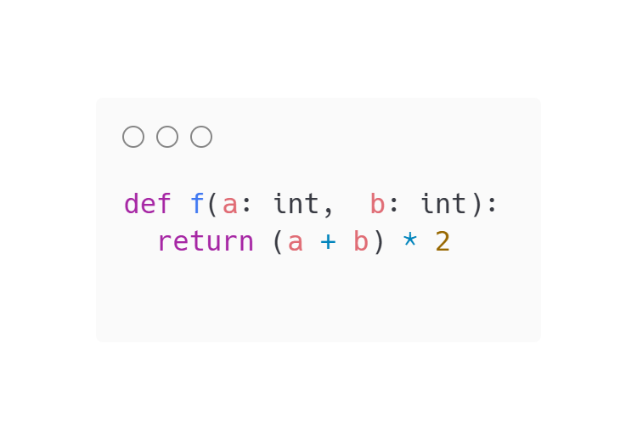
Background: Automatic Differentiation
a
b
2
Go
+
×’
c
2
Gc
×
+’
Input program
o
Ga
Gb
Intermediate representation
of the function f
Intermediate representation
of the gradient computation function f’

Slide 3
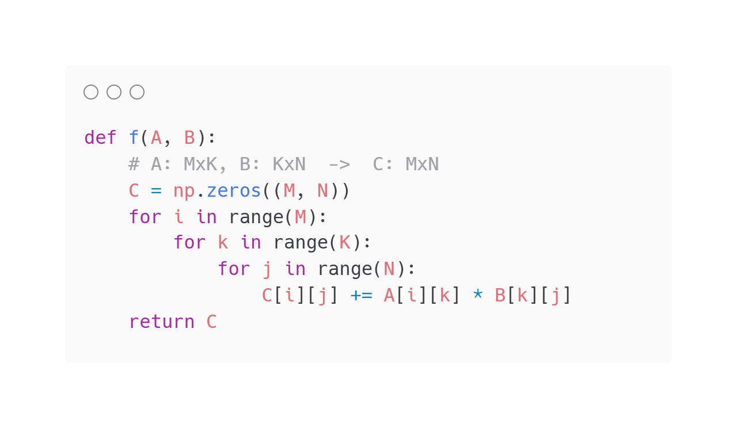
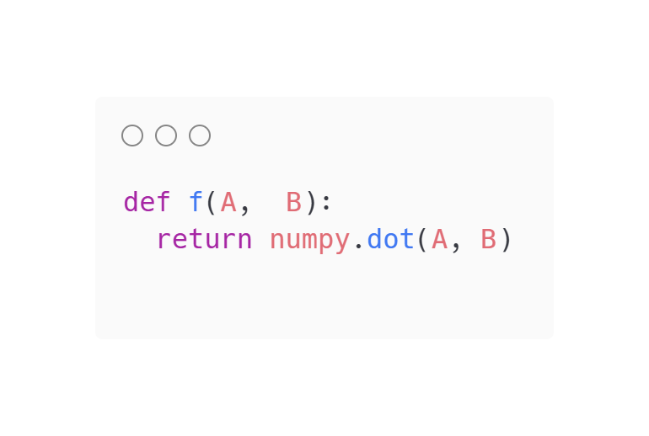
Background: Automatic Differentiation
Expand library calls
Input program
Expanded program

Slide 4
Background: Automatic Differentiation
A
B
GO
dot_forward
dot_backward
O
GA
GB
Input program
Intermediate representation
of the function f
Intermediate representation
of the gradient computation function

Slide 5
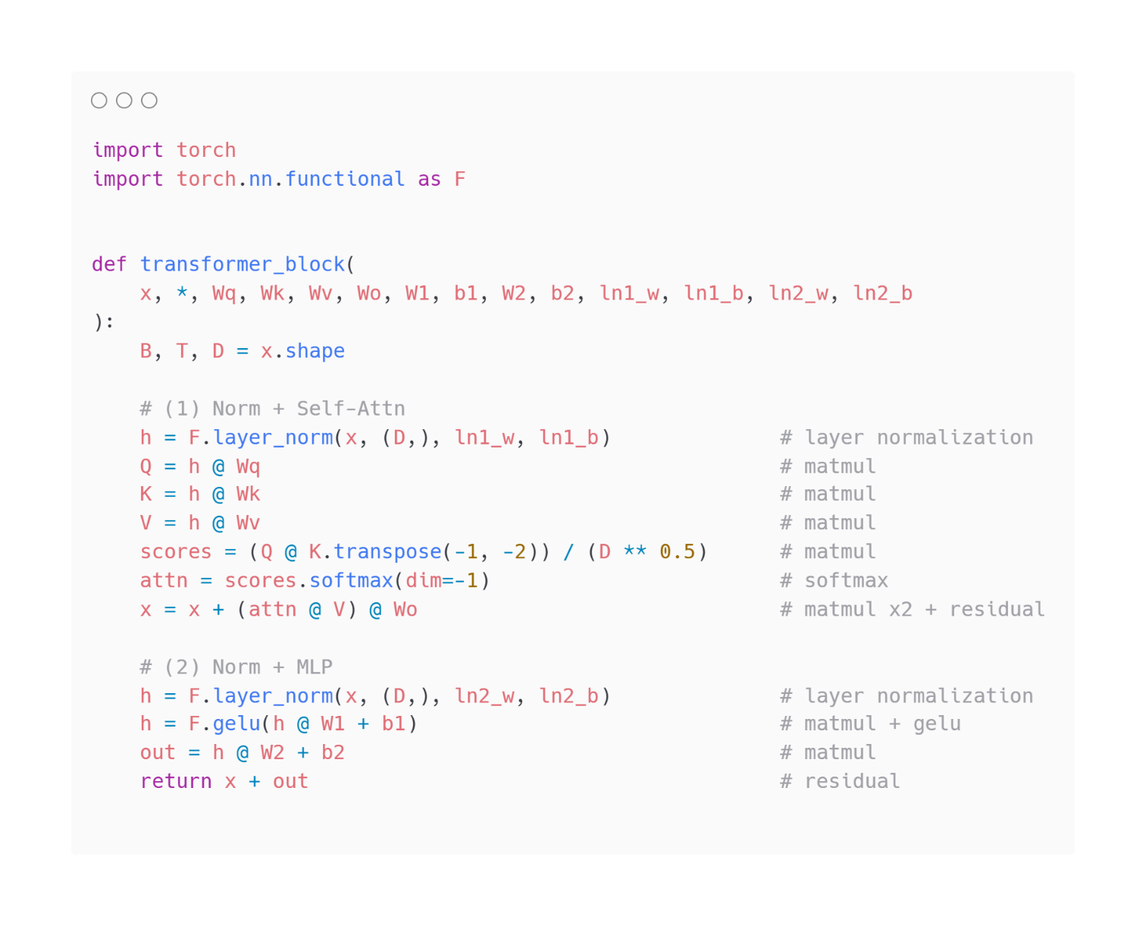
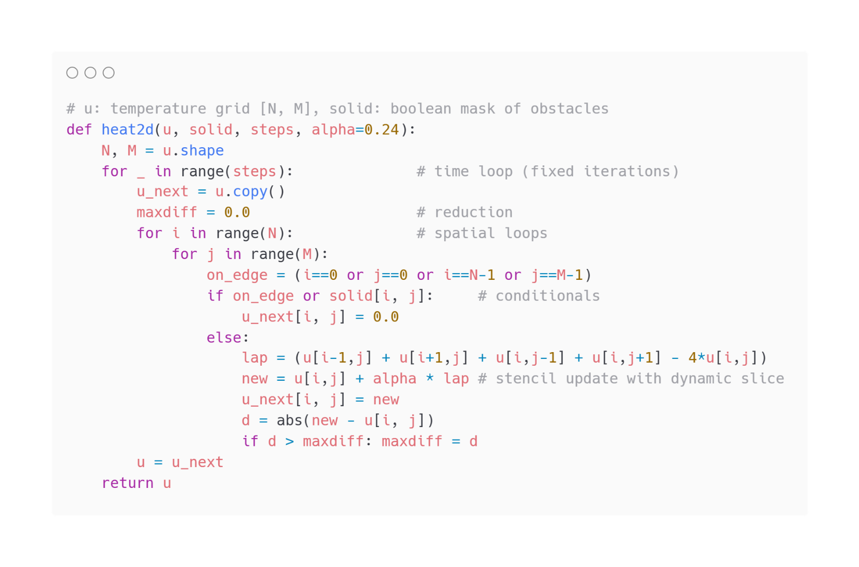
Background: Automatic Differentiation
Machine learning
Scientific computing
Notes:
Remove dynamic slice there is none in the example

Slide 6
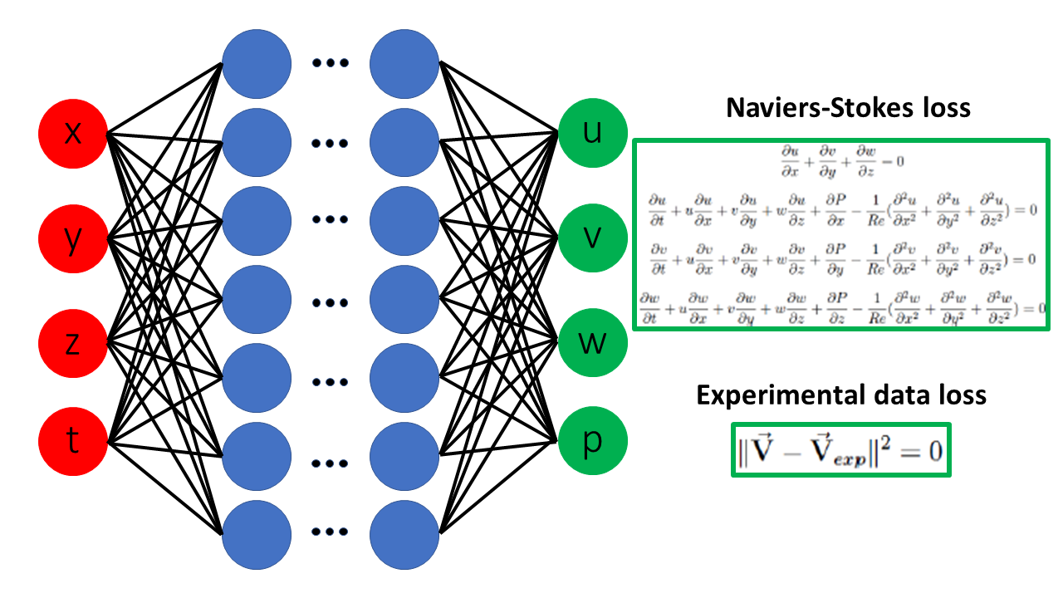
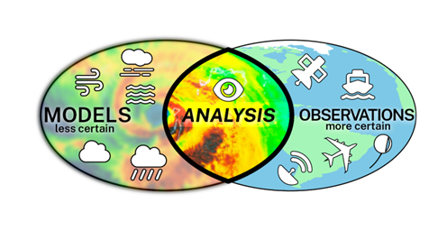
Motivation for applying AD on scientific code
Scientific applications: Data assimilation^{[1]}
AI4Science applications: Physics informed neural networks^{[2]}
[1] https://epic.noaa.gov/10-year-strategy-for-data-assimilation/
[2] https://en.wikipedia.org/wiki/Physics-informed_neural_networks

Slide 7



Existing AD solutions
Enzyme AD
Supports target programs | Machine learning
 | Scientific computing
Performance | Machine learning
 | Scientific computing
Minimal code changes required | Machine learning
 | Scientific computing
Automatic Checkpointing
PyTorch
TensorFlow
ADIFOR
DaCe AD
Zygote
JAX

Slide 8







DaCe AD Pipeline
A
GB
DaCe AD
Automatic Differentiation
Performance Optimization
B
GA
DaCe Frontends
Forward SDFG
Our Contribution
Backward SDFG
Main comparison point:
33K GitHub-stars, 8.2M monthly PyPI downloads

Slide 9
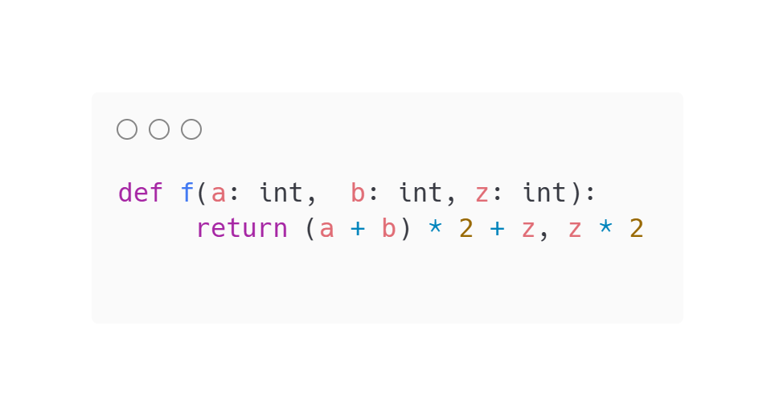
Critical Computation Subgraph (CCS)
a
b
+
c
2
z
2
×
×
o2
d
z
Input program
+
o1
Intermediate representation of the function

Slide 10
Critical Computation Subgraph (CCS)
a
b
+
c
2
z
2
×
×
o2
d
z
Input program
+
o1
Intermediate representation of the function

Slide 11
Critical Computation Subgraph (CCS)
a
b
+
c
2
z
2
×
×
o2
d
z
Input program
+
o1
Intermediate representation of the function

Slide 12
Critical Computation Subgraph (CCS)
a
b
+
c
2
z
2
×
×
o2
d
z
Input program
+
o1
Intermediate representation of the function

Slide 13
Critical Computation Subgraph (CCS)
a
b
+
c
2
z
2
×
×
o2
d
z
Input program
+
o1
Intermediate representation of the function

Slide 14
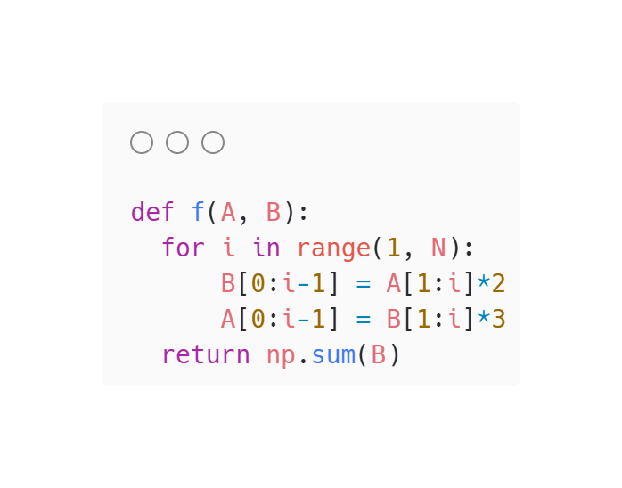
CCS extraction for sequential loops
init (i=1)
while (i<4)
A
init (i=1)
[j=1:i]
while (i<4)
A[j]
A
out=inp*2
B[j-1]
B
B
A
update i=(i+1)
[j=1:i]
B[j]
B
out=inp*3
A[j-1]
O
Input program
Full program SDFG
A
update i=(i+1)
Loop representation in the SDFG
Notes:
Let’s look at the pipeline of reversing a sequential loop and this is the new representation for loops
What I find useful for thinking about AD for loops is thinking about it in the unrolled form, here we unroll the loop, then we run the same algorithm we presented previously with the reverse BFS, from B we go back to the previous state and so on and the critical computation subgraph is in yellow
What is interesting is the the CCS of the body of the loop is not the same for all iteration but this last one is different so we cannot simple take the CCS of the body of the loop and create another loop in the backward pass but this requires more analysis, here though we notice that after a certain iteration the CCS loop body matches and we can unroll back into a loop in the backward pass, we reverse this using the same algorithm.
Initially we focused on this because JAX unrolls the for loops and this results in long compilation times, so let’s talk a bit about JAX

Slide 15
CCS extraction for sequential loops
A
A
init (i=1)
B
B
while (i<3)
init (i=1)
A
while (i<4)
A
A
Re-roll loop
A
A
A
B
…
…
B
B
A
B
Extract CCS
Unroll loop
update i=(i+1)
A
A
A
A
update i=(i+1)
A
A
B
B
B
B
O
A
A
A
B
B
B
O
O
O
Notes:
Let’s look at the pipeline of reversing a sequential loop and this is the new representation for loops
What I find useful for thinking about AD for loops is thinking about it in the unrolled form, here we unroll the loop, then we run the same algorithm we presented previously with the reverse BFS, from B we go back to the previous state and so on and the critical computation subgraph is in yellow
What is interesting is the the CCS of the body of the loop is not the same for all iteration but this last one is different so we cannot simple take the CCS of the body of the loop and create another loop in the backward pass but this requires more analysis, here though we notice that after a certain iteration the CCS loop body matches and we can unroll back into a loop in the backward pass, we reverse this using the same algorithm.
Initially we focused on this because JAX unrolls the for loops and this results in long compilation times, so let’s talk a bit about JAX

Slide 16
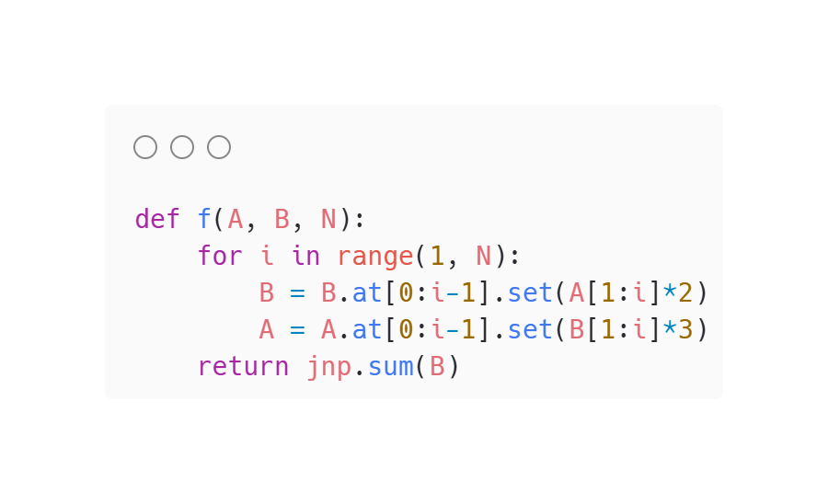
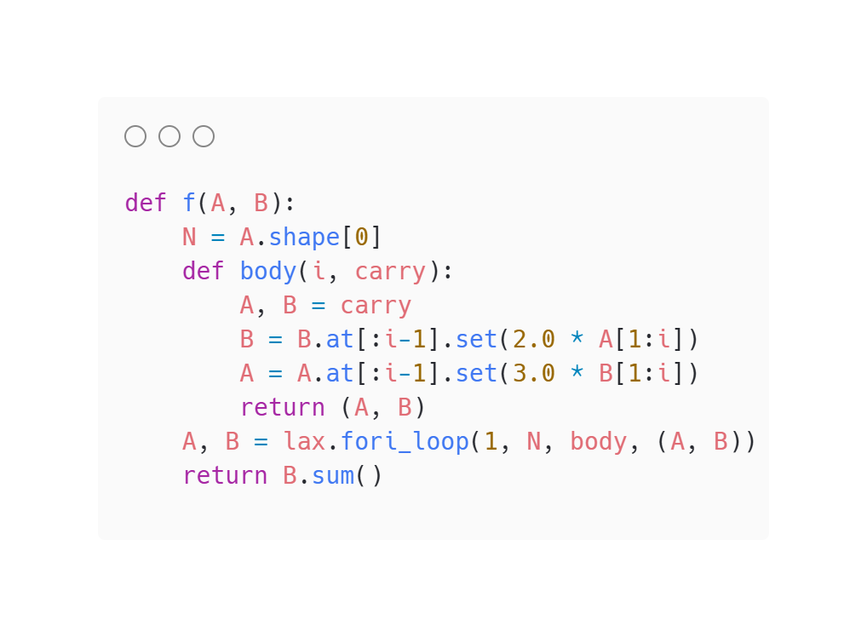
Sequential loops in JAX
JAX compatible program (python loop)
Input program
JAX JIT program (lax.fori_loop)
Notes:
Let’s look at the pipeline of reversing a sequential loop and this is the new representation for loops
What I find useful for thinking about AD for loops is thinking about it in the unrolled form, here we unroll the loop, then we run the same algorithm we presented previously with the reverse BFS, from B we go back to the previous state and so on and the critical computation subgraph is in yellow
What is interesting is the the CCS of the body of the loop is not the same for all iteration but this last one is different so we cannot simple take the CCS of the body of the loop and create another loop in the backward pass but this requires more analysis, here though we notice that after a certain iteration the CCS loop body matches and we can unroll back into a loop in the backward pass, we reverse this using the same algorithm.
Initially we focused on this because JAX unrolls the for loops and this results in long compilation times, so let’s talk a bit about JAX

Slide 17
Sequential loops in JAX
JAX IR line count change over the size of the input
JAX JIT compilation time change over the size of the input
Notes:
Let’s look at the pipeline of reversing a sequential loop and this is the new representation for loops
What I find useful for thinking about AD for loops is thinking about it in the unrolled form, here we unroll the loop, then we run the same algorithm we presented previously with the reverse BFS, from B we go back to the previous state and so on and the critical computation subgraph is in yellow
What is interesting is the the CCS of the body of the loop is not the same for all iteration but this last one is different so we cannot simple take the CCS of the body of the loop and create another loop in the backward pass but this requires more analysis, here though we notice that after a certain iteration the CCS loop body matches and we can unroll back into a loop in the backward pass, we reverse this using the same algorithm.
Initially we focused on this because JAX unrolls the for loops and this results in long compilation times, so let’s talk a bit about JAX

Slide 18
Reversing elements to extract the gradient computation graph
a
b
+
c
2
×
Input program
o
Intermediate representation
of the function
Notes:
Let’s look at the pipeline of reversing a sequential loop and this is the new representation for loops
What I find useful for thinking about AD for loops is thinking about it in the unrolled form, here we unroll the loop, then we run the same algorithm we presented previously with the reverse BFS, from B we go back to the previous state and so on and the critical computation subgraph is in yellow
What is interesting is the the CCS of the body of the loop is not the same for all iteration but this last one is different so we cannot simple take the CCS of the body of the loop and create another loop in the backward pass but this requires more analysis, here though we notice that after a certain iteration the CCS loop body matches and we can unroll back into a loop in the backward pass, we reverse this using the same algorithm.
Initially we focused on this because JAX unrolls the for loops and this results in long compilation times, so let’s talk a bit about JAX

Slide 19
Reversing elements to extract the gradient computation graph
a
b
2
Go
c=a+b
Gc=Go*2
c
2
Gc
Ga=Gc*1
Gb=Gc*1
o=c*2
Input program
o
Ga
Gb
Intermediate representation
of the function
Intermediate representation
of the gradient computation function

Slide 20
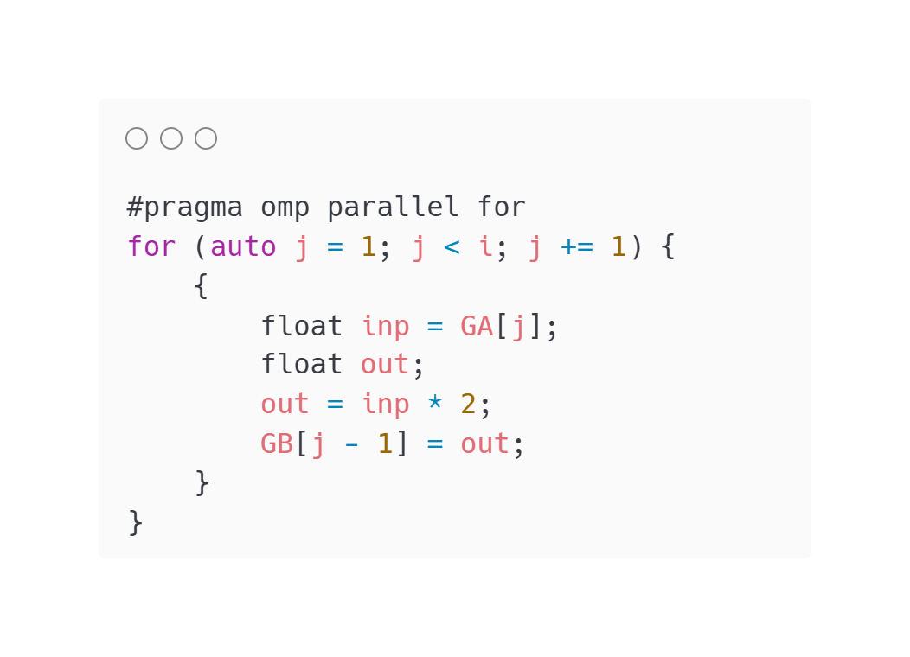
Reversing elements to extrcat the gradient computation graph
init (i=1)
while (i<3)
GO
A
GB
B
GB
GA
A
GA
[j=1:i]
Reverse CCS
GA[j]
update i=(i+1)
A
init (i=2)
out=inp*2
while (i≥1)
GB[j-1]
GA
B
GB
GB
A
Generated C++
B
GA
update i=(i-1)
O

Slide 21
Dynamic slicing and bound checking in JAX
Each dynamic slice in the loop translates to:
Get a fixed-size slice of size N-1 of A
Compute the multiplication in a new array: cand=2*A[1:]
Make a boolean mask for the prefix we want to update at step i mask = arange(N-1) < (i-1)
Blend the old values of B (old= B[:N-1]) with the new values of cand: mixed = where(mask, cand, old)
Put mixed (size N-1) back into B (size N) with: B' = dynamic_update_slice(B, mixed, start=0)
JAX JIT program
Notes:
Let’s look at the pipeline of reversing a sequential loop and this is the new representation for loops
What I find useful for thinking about AD for loops is thinking about it in the unrolled form, here we unroll the loop, then we run the same algorithm we presented previously with the reverse BFS, from B we go back to the previous state and so on and the critical computation subgraph is in yellow
What is interesting is the the CCS of the body of the loop is not the same for all iteration but this last one is different so we cannot simple take the CCS of the body of the loop and create another loop in the backward pass but this requires more analysis, here though we notice that after a certain iteration the CCS loop body matches and we can unroll back into a loop in the backward pass, we reverse this using the same algorithm.
Initially we focused on this because JAX unrolls the for loops and this results in long compilation times, so let’s talk a bit about JAX

Slide 22
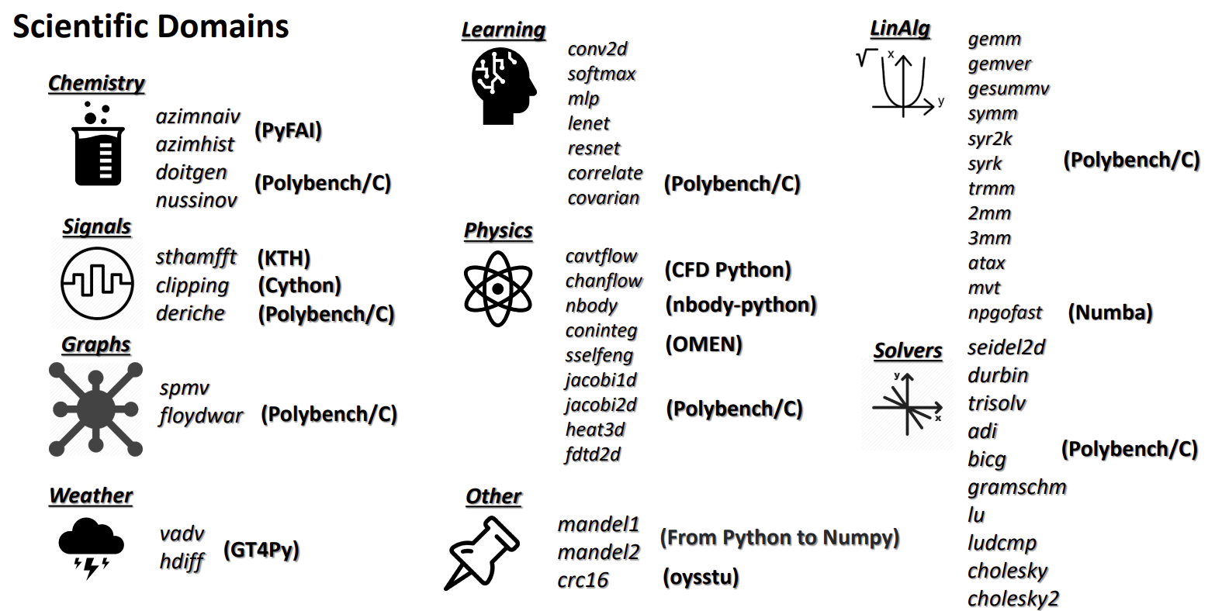
Performance evaluation vs. JAX JIT on NPBench
We run on two Intel® Xeon®Gold 6154 CPUs (18 cores per CPU, 72 logical processors) running at 3.00 GHz (max 3.7 GHz). This x86_64 architecture supports AVX-512, FMA, and SSE4.2 instructions. The system has two NUMA nodes, with a cache hierarchy of 32 KB L1, 1 MB L2 per core, and 25 MB L3 per CPU.
https://github.com/spcl/npbench

Slide 23
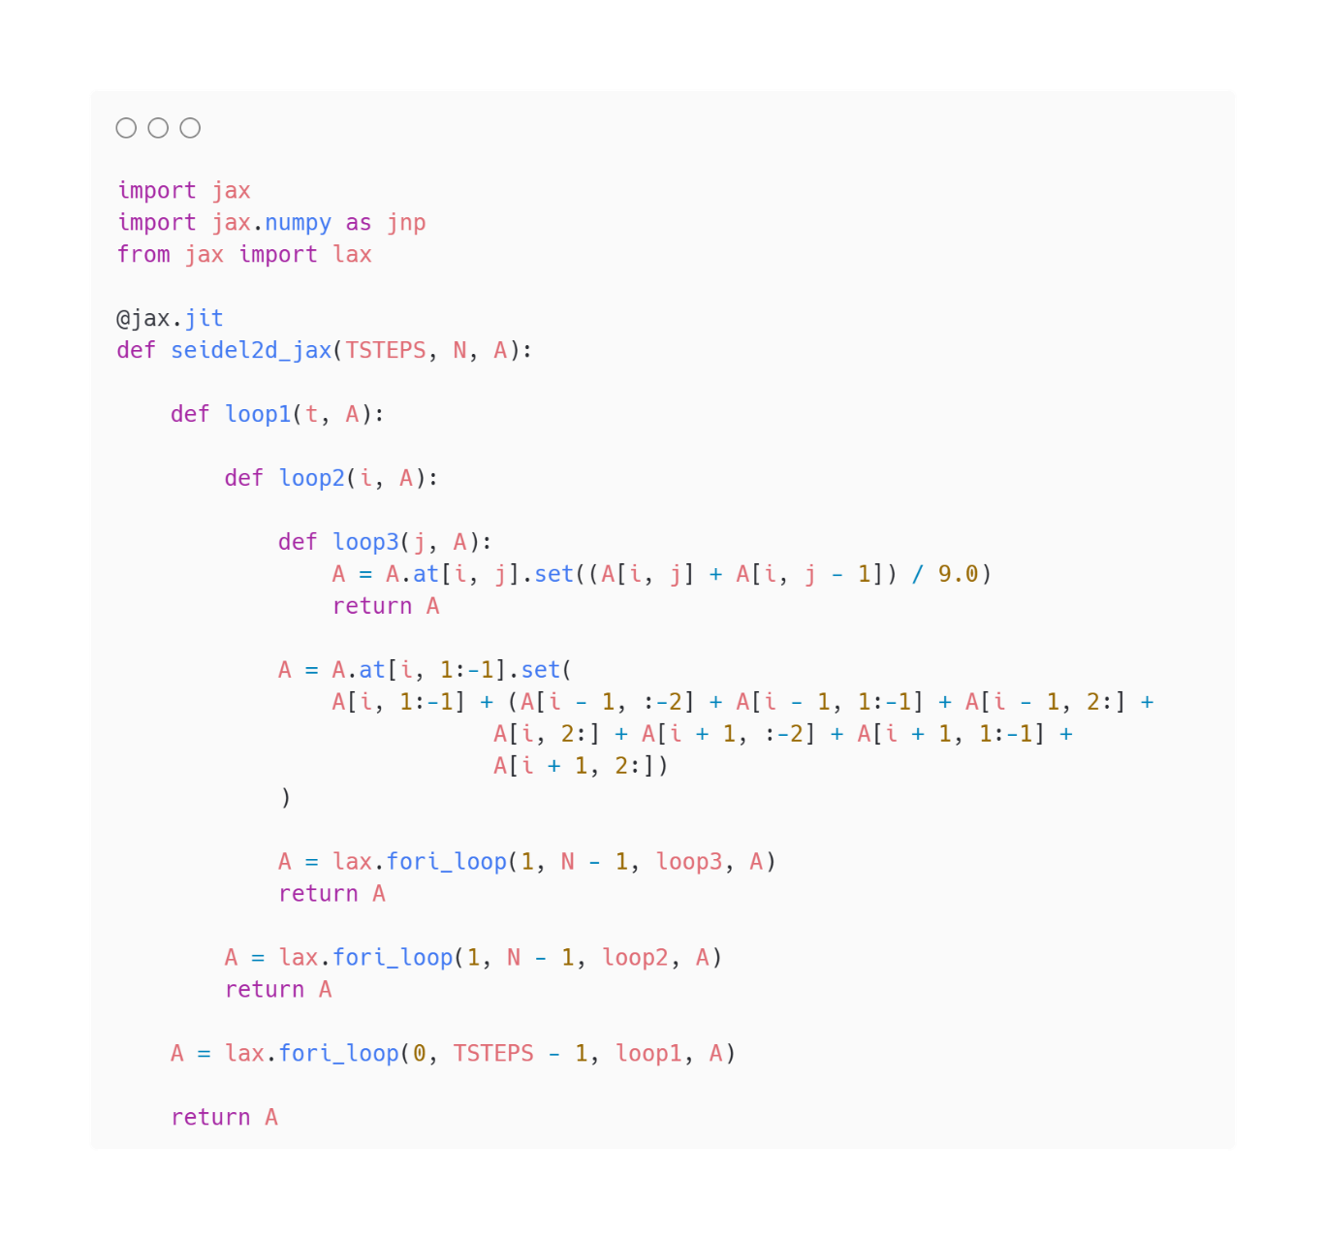
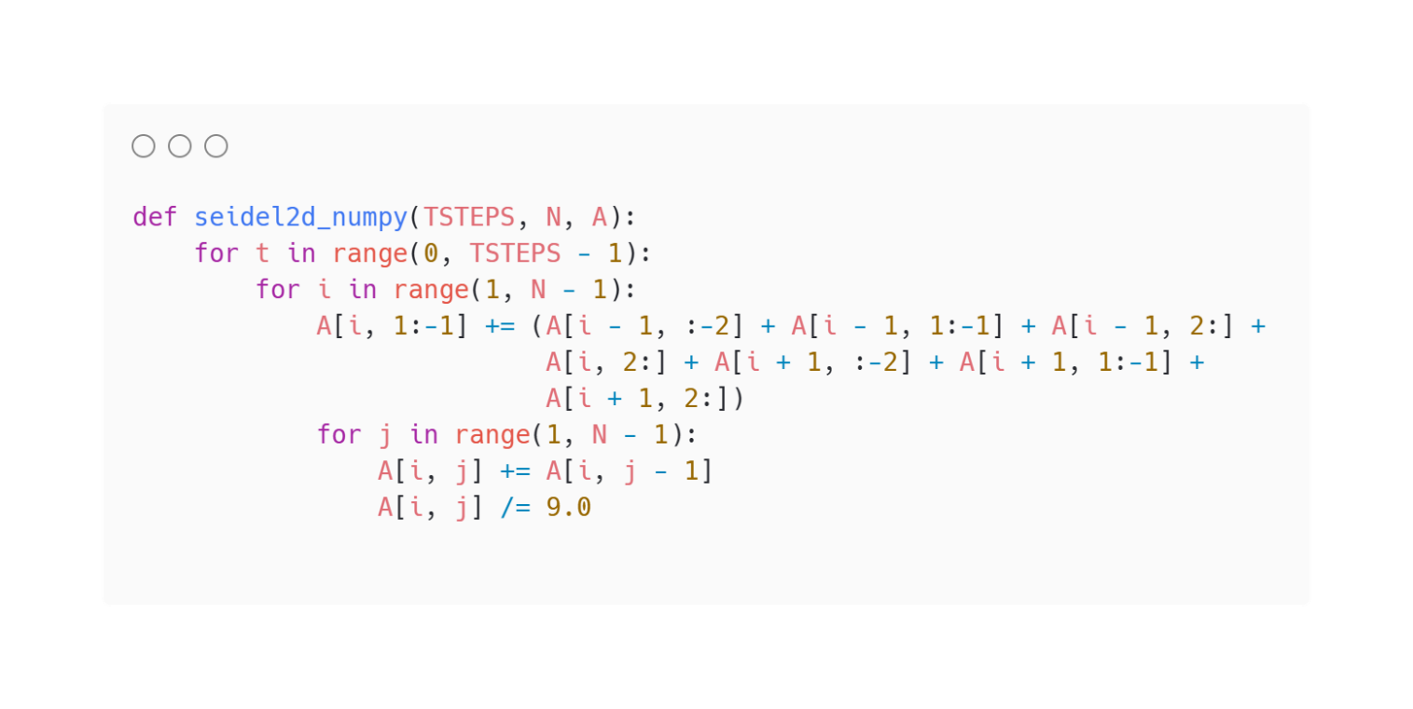
JAX: Example of necessary rewrites
Original NumPy code
Modified JAX code

Slide 24
DaCe AD Performance: Vectorized programs
Average speedup: 1.43×
Geo-mean: 1.26×
DaCe AD
JAX JIT

Slide 25
DaCe AD Performance: Non-vectorized programs
14s
9s
17s
9s
2779s
2849s
10s
33s
6.81×
965s
1470s
717s
1565s
1523s
Average speedup: 134×
Geo-mean: 7.1×
DaCe AD
JAX JIT
Notes:
Non-vectorized programs which are the majority in NPBench, show the performance issues previously presented where we outperformance JAX with two orders of magnitude on average. There are still some cases where we are being outperformed and from my experience this is mainly due to conservative gradient accumulation and storing …

Slide 26
DaCe AD Performance: Seidel2D case study
1.7 mins
15 mins
34 mins
2.8 mins
9.4 mins
23 mins
47 mins
8s
19s
36s
1 min
5.4 mins
Efficient in-place gradient propagation.
DaCe AD is 2724× faster than JAX.
DaCe AD
JAX JIT
Two main reasons for the performance difference:
Array immutability and dynamic slicing inefficiency: JAX uses lax.dynamic_slice for non-static indices, whereas DaCe AD directly accesses memory, leading to faster execution.
Extra bounds checking: JAX includes bound checks during loops to ensure safe gradient propagation, while DaCe handles this more efficiently at the SDFG Memlet level.

Slide 27
JAX JIT performance on GPU
51s
97s
288s
DaCe AD [CPU]
JAX JIT [V100 GPU]

Slide 28
Store-recompute problem in AD
Notes:
Let’s look at the pipeline of reversing a sequential loop and this is the new representation for loops
What I find useful for thinking about AD for loops is thinking about it in the unrolled form, here we unroll the loop, then we run the same algorithm we presented previously with the reverse BFS, from B we go back to the previous state and so on and the critical computation subgraph is in yellow
What is interesting is the the CCS of the body of the loop is not the same for all iteration but this last one is different so we cannot simple take the CCS of the body of the loop and create another loop in the backward pass but this requires more analysis, here though we notice that after a certain iteration the CCS loop body matches and we can unroll back into a loop in the backward pass, we reverse this using the same algorithm.
Initially we focused on this because JAX unrolls the for loops and this results in long compilation times, so let’s talk a bit about JAX

Slide 29
DaCe AD: Store-recompute problem
X
GZ
stored_Y
Stored arrays are used in the backward pass.
Y=2*X
GY=2*stored_Y*G_Z
Y
GY
No additional computation necessary.
Z = Y ** 2
stored_Y
GX = GY * 2
Z
GX
Forward SDFG
Backward SDFG
Storing arrays for the backward pass.

Slide 30
DaCe AD: Store-recompute problem
X
recomputed_Y=2*X
GZ
recomputed_Y
X
No memory cost in the forward pass.
GY=2*recomputed_Y*G_Z
Y=2*X
Y
GY
A computational and memory cost in the backward pass due to recomputing Y.
Z = Y ** 2
GX = GY * 2
Z
GX
Forward SDFG
Backward SDFG
Recomputing arrays in the backward pass.

Slide 31
DaCe AD: Store-recompute problem
Cavity flow example with arrays of size: [1024x1024]
Total memory usage without storing: 128 MiB
Storing memory consumption: 0.092*timesteps GiB
After 100 timesteps only, the storing is 98.6% of the memory usage of the program (9.2 GiB vs 128 MiB)
For >4000 timesteps, the memory usage is over 360 GiB

Slide 32
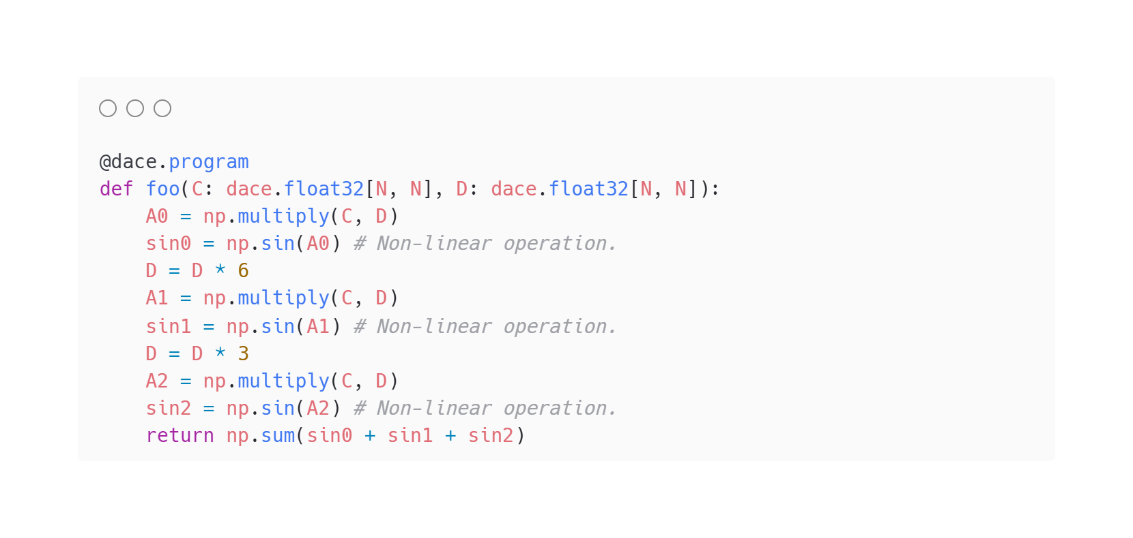
DaCe AD: Store-recompute problem
We have n arrays to decide on whether to store or recompute
We have n binary variables, one for each array
We model the memory usage of the program
We identify where the store and recomputation will be in the program and how would they change the memory usage
We formulate an ILP and solve for the optimal combination of the binary variables

Slide 33
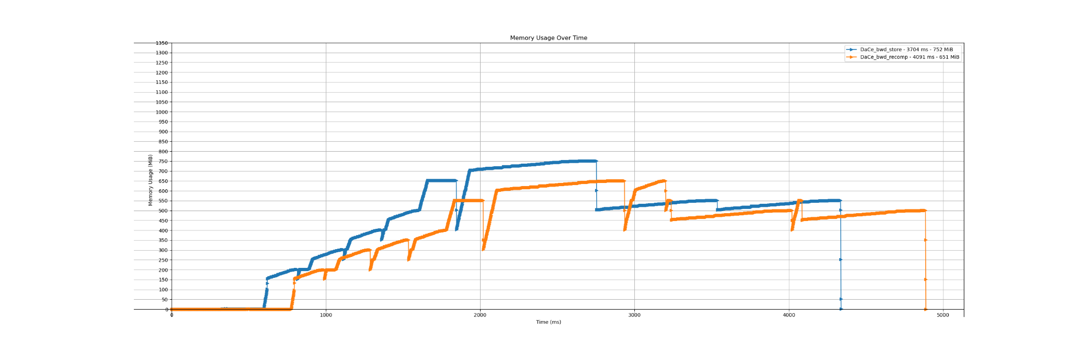
DaCe AD: Store-recompute ILP example
DaCe_bwd_store - 3704 ms - 752 MiB
DaCe_bwd_recomp - 4091 ms - 651 MiB
1200
1100
1000
900
800
Memory usage (MiB)
700
600
500
400
300
200
100
0
2000
3000
4000
5000
1000
Time (ms)
Memory usage overtime: store vs. recompute

Slide 34




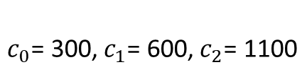

DaCe AD: Store-recompute ILP example
Binary decision variables:
if array 0 should be stored
if array 0 should be recomputed
Storage sizes:
$$v_{0},v_{1},v_{2}∈\{0,1\}$$
$$v_{0}= 1$$
$$SA_{0}\text{= }SA_{1}\text{= }SA_{2}\text{= 50}$$
$$v_{0}= 0$$
Computational costs:
Peak memory usage of each recomputation block:
$$c_{0}\text{= 300,}{ c}_{1}\text{= 600,}{ c}_{2}\text{= 1100}$$
$$RA_{0}\text{= 50,} RA_{1}\text{= 70,} RA_{2}\text{= 150}$$
The objective function to minimize will be:
$$f\left(v_{0},v_{1},v_{2}\right)=c_{0}∗\left(1−v_{0}\right)+c_{1}∗\left(1−v_{1}\right)+c_{2}∗\left(1−v_{2}\right)$$
$$f\left(v_{0},v_{1},v_{2}\right)=300∗\left(1−v_{0}\right)+600∗\left(1−v_{1}\right)+1100∗\left(1−v_{2}\right)$$

Slide 35

DaCe AD: Store-recompute ILP example
We only have one constraint which is that the peak memory usage of the program doesn’t surpass a user-defined limit.
We model the memory usage of the program as a sequence of measurements some of which are a function of the decision variables such that
To linearize the max function we introduce an auxiliary variable t such that our constraints are:
C being the user defined memory limit. In this example C = 500

Slide 36
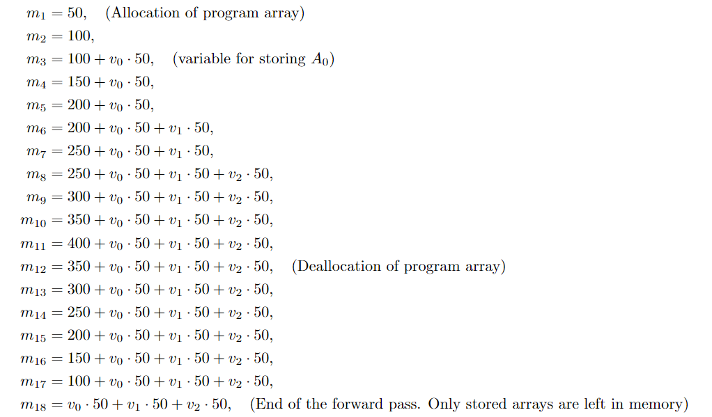
DaCe AD: Store-recompute ILP example measurements

Slide 37
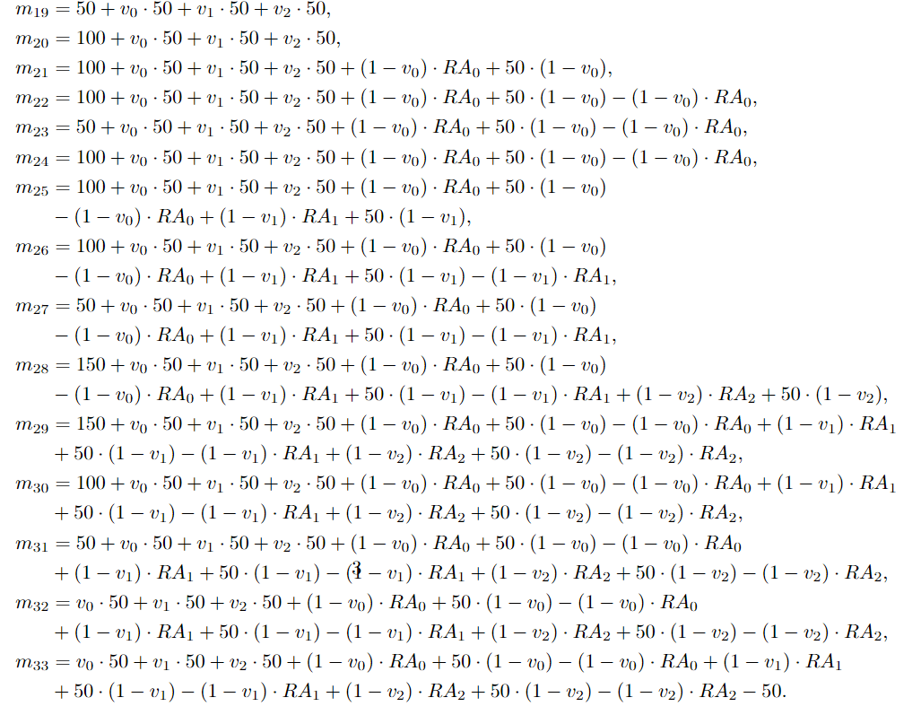
DaCe AD: Store-recompute ILP example measurements

Slide 38
DaCe AD: Store-recompute ILP solution results
C-0
C-1
C-2
C-3
C-4
C-5
C-6
C-7
Other configurations
ILP-selected configuration
User-set memory limit 500 MiB

Slide 39
A
DaCe AD
Gradient B
Automatic Differentiation
ILP-based Checkpointing
B
Performance Optimization
Gradient A
DaCe Frontends
Forward SDFG
Our Contribution
Backward SDFG
6.8×
8.5×
63×
227×
2724×
Average speedup: 92×
Geo-mean: 4.1×
Results preview: DaCe AD vs JAX JIT
DaCe AD
JAX JIT
☑
No code changes required
☑
Mutable array support with efficient indexing and slicing for AD
Automatic ILP-based checkpointing
☑
Support for multiple sources for ML (PyTorch/ONNX) and scientific computing (Fortran/Python)
☑
Up to 2700x speedup vs JAX JIT on NPBench gradient calculation
☑

Slide 40

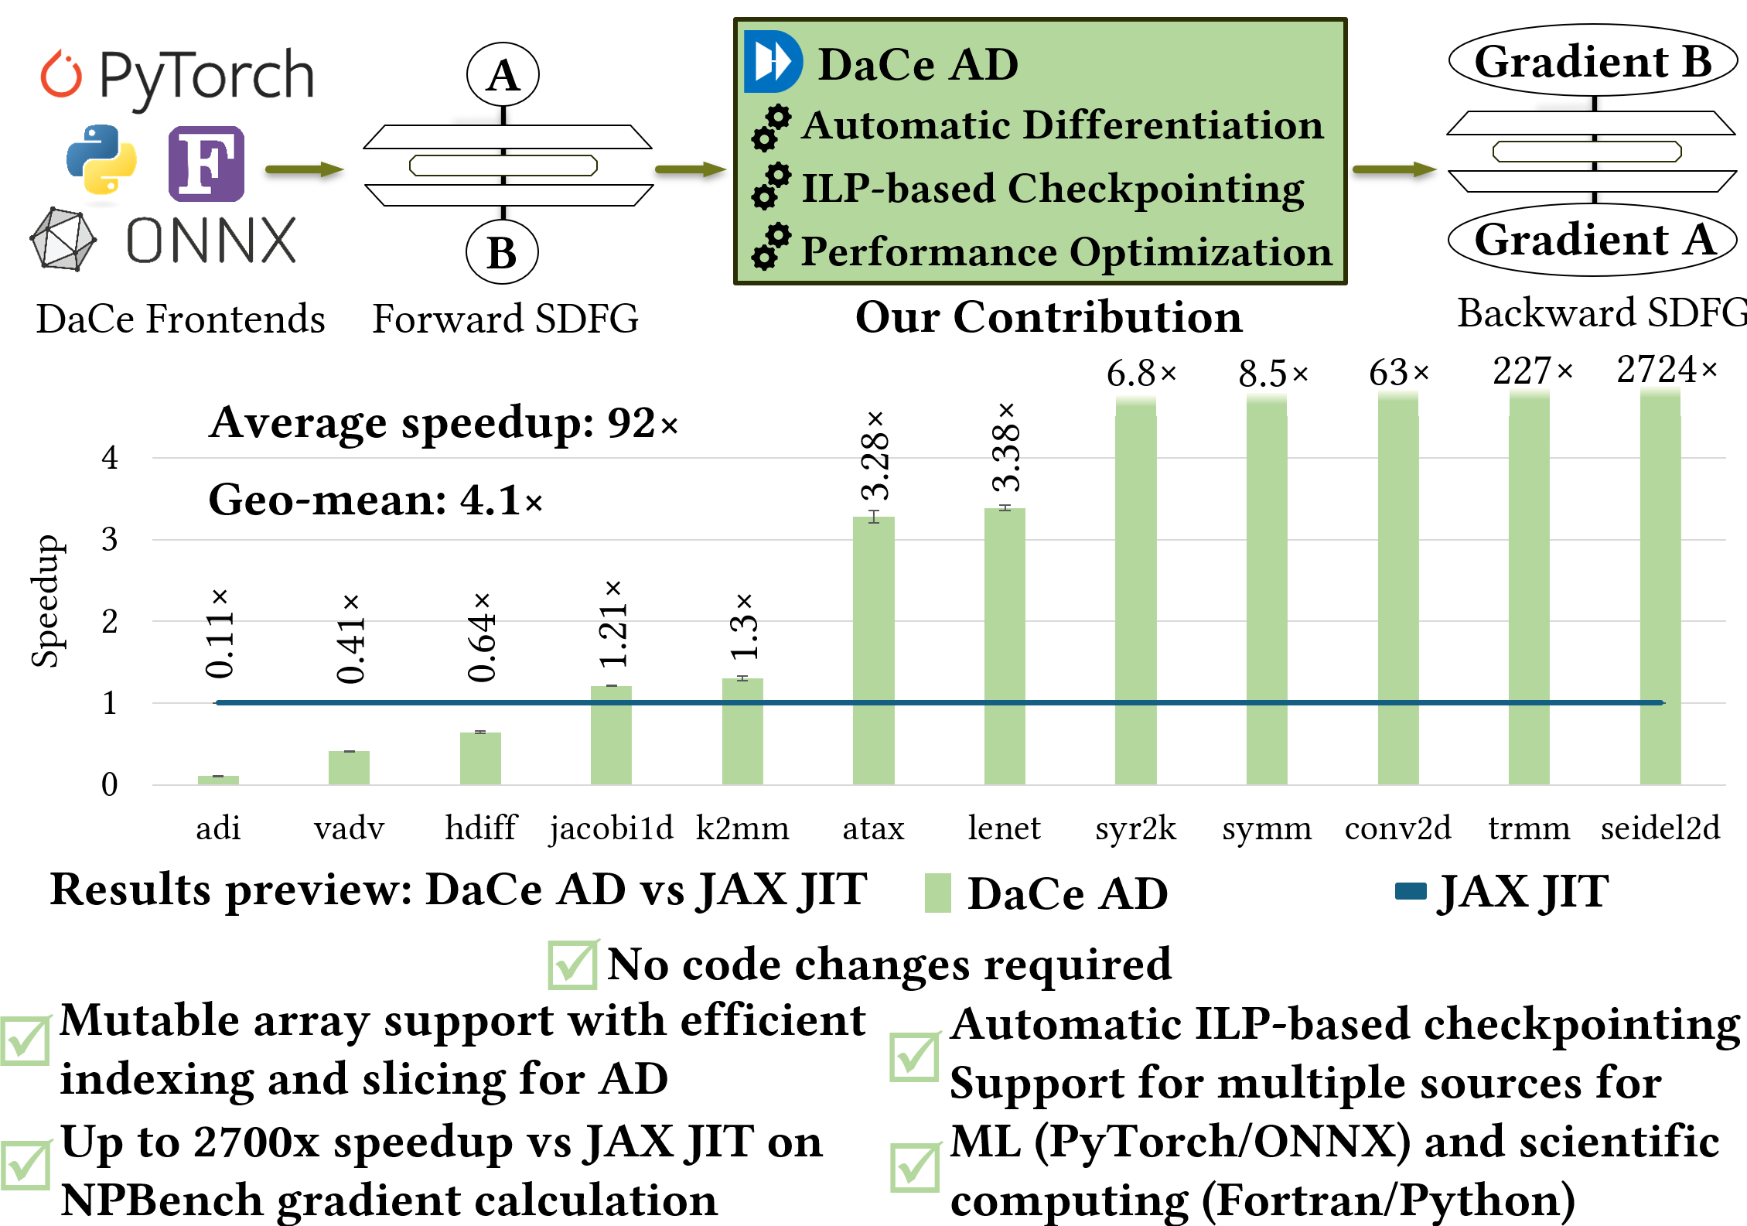

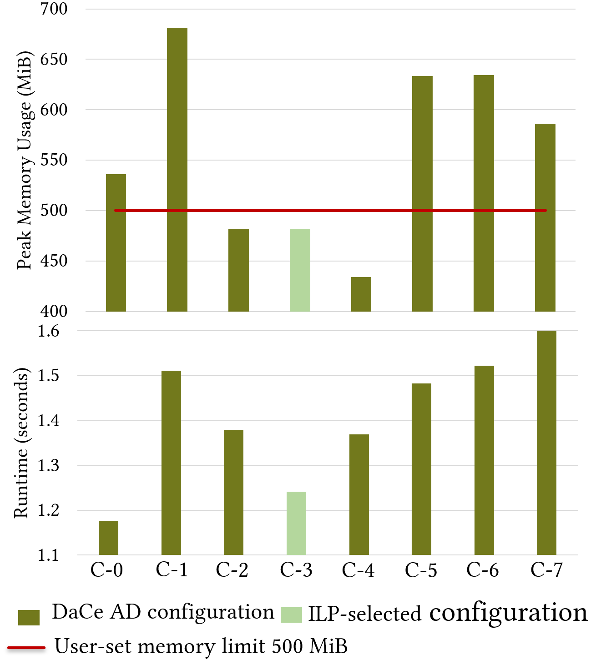
Conclusions
More of SPCL’s research:
youtube.com/@spcl
210+ Talks
Average speedup: 1.43×
Geo-mean: 1.26×
twitter.com/spcl_eth
1.6K+ Followers
github.com/spcl
5.6K+ Stars
… or spcl.ethz.ch
TensorFlow
Enzyme AD
DaCe AD
Supports target programs | Machine learning
 | Scientific computing
Performance | Machine learning
 | Scientific computing
Minimal code changes required | Machine learning
 | Scientific computing
Automatic Checkpointing
PyTorch
Zygote
ADIFOR
JAX

