Slide 1
ATLAHS: An Application-centric Network Simulator Toolchain for AI, HPC and Distributed Storage
Siyuan Shen¹*, Tommaso Bonato¹*, Zhiyi Hu¹, Pasquale Jordan¹, Tiancheng Chen¹, Torsten Hoefler¹
¹ ETH Zurich, * Equal contribution

Slide 2




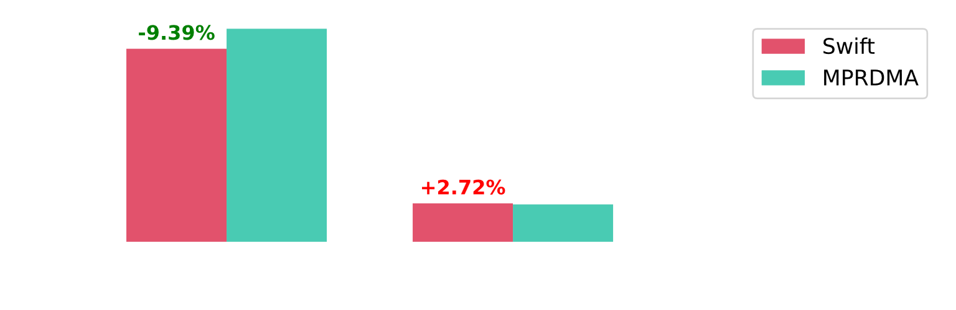
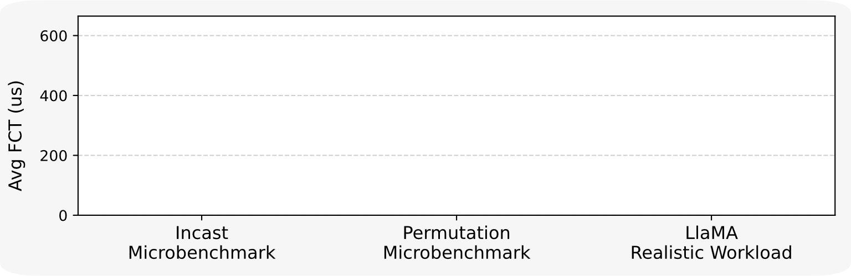







Importance of Real Application Traces: An Example
Pipeline Parallelism (PP = 2)
Gradient synchronization is done with Allreduce
$$…$$
Backpropagation
Ring allreduce for data parallelism (DP)
Comp
BWD
Pipeline parallelism (PP) affected by long running allreduce
Partition 0
Partition 1
Node 8
DP
Streams
Allreduce
PP
Layer $L_{n}$
Send
Forward
$$…$$
Time
Input
Loss
Comp
Node 0
Backward
Node 8
BWD
Node 0
DP
Streams
Allreduce
Forward
PP
Receive
Layer $L_{n−1}$
Input
Loss
PP Victim Flow
Node 1
Backward
Node 9
Data Parallelism (DP = 8)
Forward
Input
Loss
DP Ring Allreduce
Node 2
Backward
Node 10
$$…$$
$$…$$
N0
N1
N2
N3
N8
N9
N10
N11
$$⋮$$
$$⋮$$
Forward
Input
Loss
Node 7
Backward
Node 15
Implemented with point-to-point operations (i.e., send, receive)
Notes:
--llama

Slide 3
Importance of Real Application Traces: An Example
x
Pipeline Parallelism (PP = 2)
Gradient synchronization is done with Allreduce
$$…$$
Backpropagation
Ring allreduce for data parallelism (DP)
Comp
BWD
Pipeline parallelism (PP) affected by long running allreduce
Partition 0
Partition 1
Node 8
DP
Streams
Allreduce
PP
Layer $L_{n}$
Send
Forward
$$…$$
Time
Input
Loss
We need an application-centric approach for generating workloads for network simulators
Node 0
Backward
Node 8
Comp
BWD
Node 0
DP
Streams
Allreduce
Forward
PP
Receive
Layer $L_{n−1}$
Input
Loss
PP Victim Flow
Node 1
Backward
Node 9
Data Parallelism (DP = 8)
Forward
Input
Loss
DP Ring Allreduce
Node 2
Backward
Node 10
$$…$$
$$…$$
N0
N1
N2
N3
N8
N9
N10
N11
$$⋮$$
$$⋮$$
Forward
Input
Loss
Node 7
Backward
Node 15
Implemented with point-to-point operations (i.e., send, receive)

Slide 4






Why Another Simulator?
Simulator Toolchains
Requirements
LogGOPSim [1]
CODES [3]
AstraSim [5]
SimAI [7]
Support real applications from various domains (e.g., HPC, AI, distributed storage, etc.)
HPC
HPC
AI
AI
Allow all types of workloads to be stored and executed in a standardized trace format (not ad-hoc)
GOAL [2]
OTF [4]
Chakra [6]
The trace format and the toolchain need to be flexible and extensible
[1] Hoefler et al. (2010). LogGOPSim: simulating large-scale applications in the LogGOPS model. HPDC
[2] Hoefler et al. (2009). Group operation assembly language - a flexible way to express collective communication. International Conference on Parallel Processing
[3] Jain et al. (2016). Evaluating HPC Networks via Simulation of Parallel Workloads. SC
[4] Knüpfer et al. (2006). Introducing the Open Trace Format (OTF). In Lecture notes in computer science
[5] Won et al. (2023). ASTRA-sim2.0: Modeling Hierarchical Networks and Disaggregated Systems for Large-model Training at Scale. ISPASS
[6] Sridharan et al. (2023). Chakra: Advancing Performance Benchmarking and Co-design using Standardized Execution Traces. arXiv
[7] Wang et al. (2025). SimAI: Unifying Architecture Design and Performance Tuning for Large-Scale Large Language Model Training with Scalability and Precision. NSDI
Notes:
Fully open source?
Compressed

Slide 5











ATLAHS Toolchain
ATLAHS: Application-centric Network Simulator Toolchain for AI, HPC, and Distributed Storage
Custom tracers and parsers can be added to support more applications
Applications
Trace Files
GOAL Format
Workload Simulation
NCCL
Tracer
AI
Scheduler
Node
Collective Algorithm
I/O
$$C_{0}$$
Stream 0
MPI
GPU 0
NCCL
Configuration
Send
Allreduce
Inter-node and intra-node sends and receives
Network Backend
GPU 1
Stream 1
$$C_{1}$$
$$S$$
...
Recv
Broadcast
Network Topology
Input Parameters
LogGOPSim
PMPI
Tracer
HPC
Block I/O Tracer
Storage
Latency
Node
Number of Ranks
$$C_{2}$$
htsim
Node
Example: Azure Direct Drive
Bandwidth
Application
Application
Coordinator
Block Storage
Collective Algorithm
CC Algorithm
Write
Read
...
NS3
MPI
Metadata
$$R$$
MTU
...
Virtual Disk Client
Load Balancer
Synthetic Workloads
...
...
P2P, Collectives
Gateway
Red: Application and hardware components
Green: Trace processing
Blue: Simulation
Notes:
Grey parameters

Slide 6






Group Operation Assembly Language (GOAL): A Unifying Trace Format
Textual Format
DAG Schedule
Directed Acyclic Graph (DAG)
rank 0 {
l1: calc 100
l2: calc 200
l3: calc 200
l2 requires l1
l3 requires l1
l4: send 10b to 1
l4 requires l2
l4 requires l3
}
calc 100
Vertices represent tasks:
Send
Receive
Computation
$$l1$$
cpu 0
cpu 1
Compute Stream 0
Compute Stream 1
$$l2$$
$$l3$$
calc 200
calc 200
Edges define dependencies between tasks
$$l4$$
send 10b
Stored and executed in binary format: light-weight, storage space efficient
Tasks can be assigned to different hardware resources by using cpu and nic labels
Simple and intuitive structure: easy to adapt and extend

Slide 7




Workload Generation: HPC
MPI Program
MPI_Init(NULL, NULL);
MPI_Comm_size(MPI_COMM_WORLD, &size); MPI_Irecv(&received, 1, MPI_INT, SENDER, 0,
MPI_COMM_WORLD, &request);
Program traced with liballprof [1] relying on the PMPI interface
MPI Trace
MPI_Init:0:0
MPI_Comm_size:7:0:256:8
MPI_Irecv:1547003:0:3500:15:1:1:5:6:1547032
Start time
Other arguments
End time
GOAL generated with Schedgen [1]
Computation inferred from timestamps between consecutive MPI operations
GOAL Schedule
Collectives decomposed into individual sends and receives
$$C_{1}$$
$$C_{0}$$
$$C_{2}$$
$$R$$
$$S$$
[1] Hoefler et al. (2010). LogGOPSim: simulating large-scale applications in the LogGOPS model. HPDC

Slide 8
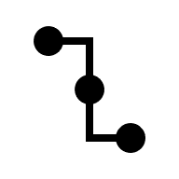

























Workload Generation: AI
Node 1
Stream DAGs
Collective Decomposition DAGs
Stream 0
$$D_{0}$$
$$t_{2}−t_{1}$$
Stream 0
Dummy
STAGE 3
Collectives are replaced with point-to-point algorithms
GPU 2
Send
$$C_{0}$$
Bcast
$$C_{0}$$
$$C_{1}$$
GPU 0
GPU 3
$$D_{0}$$
$$D_{1}$$
Allreduce
$$C_{1}$$
$$S_{0}$$
$$S_{1}$$
$$S_{2}$$
GPU 1
Dummy
Stream 1
$$t_{3}−t_{5}$$
GPU 0
GPU 1
GPU 2
GPU 3
Node 0
...
STAGE 2
STAGE 4
$$⋮$$
$$⋮$$
AI App
nsys profile
$$C_{i}$$
$$C_{j }$$
Nsys Report Files
GOAL
NCCL
Stream 0
$$D_{1}$$
STAGE 1
GPU 0
Send
Bcast
Node 0
Node 1
Stream 1
GPU 0
$$t_{0}$$
$$t_{1}$$
$$t_{2}$$
$$t_{3}$$
NCCL with additional nvtx annotations
Stream 1
Ops from different CUDA streams are assigned different compute streams in GOAL
GPU 1
GPU 1
Allreduce
GPU 0
GPU 1
GPU 2
GPU 3
...
$$t_{4}$$
$$t_{5}$$

Slide 9



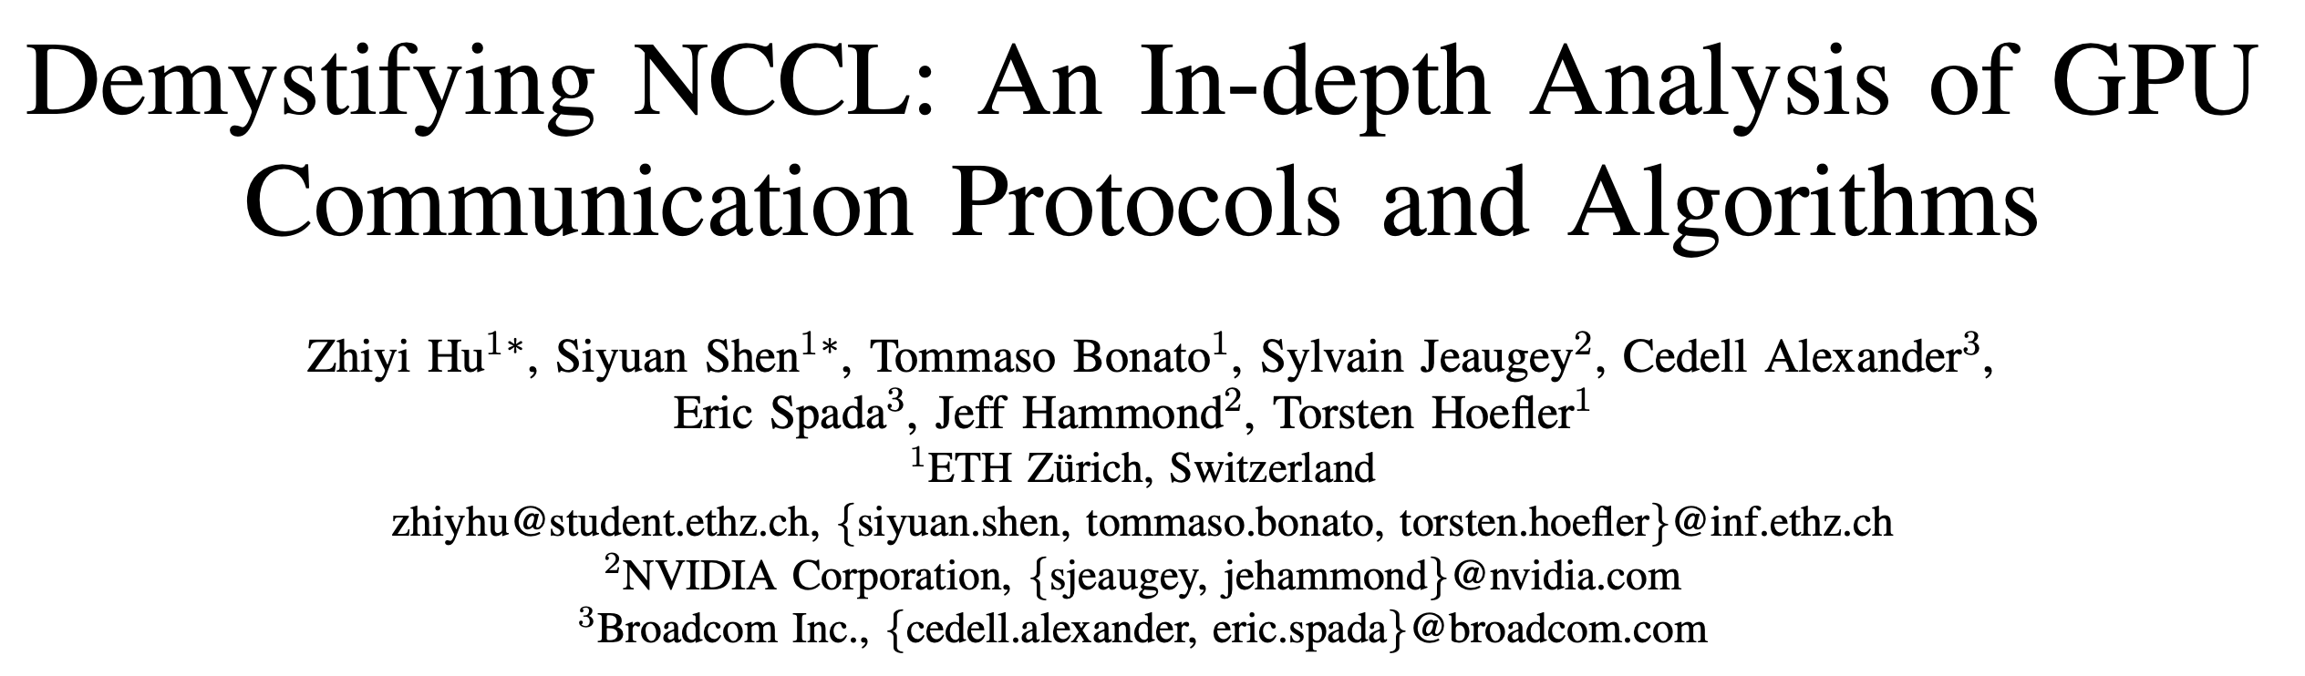
Decomposition for NCCL Collectives
Implementation of NCCL collectives depends on
Node 0
NCCL uses
1 SM
Node 1
Number of NCCL channels
GPU 0
GPU 2
SM
SM
GPU 3
Communication Protocol: Simple, LL, LL128
SM
SM
Timeline
Algorithm: Ring, Tree, NVLS, CollNet, etc.
NCCL Ring Broadcast (2MB)
NCCL’s Iterative execution model
Send to GPU2 (0.5MB)
Send to GPU2 (0.5MB)
Send to GPU2 (0.5MB)
Send to GPU2 (0.5MB)
GPU 1
Converting NCCL collectives into GOAL is complex

Slide 10


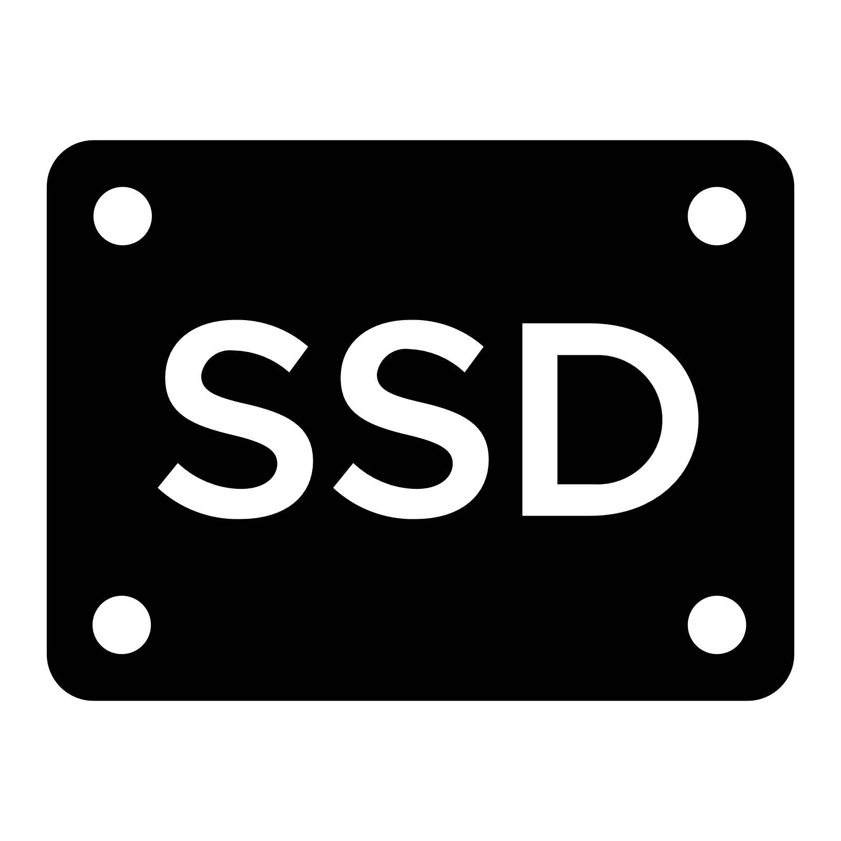














Workload Generation: Distributed Storage System
Example System: Azure Direct Drive
CCS: Change Coordinate Service
Node
CCS₀
CCS₁
...
CCS_{N}
BSS: Block Storage Service
Application
Write
Read
BSS₀
BSS₁
BSS_{M}
MDS: Metadata Service
Virtual Disk Client (VDC)
...
Traced with bpftrace
Stored in SPC format
GS: Gateway Service
SLB
GS
MDS
SLB: Software Load Balancer
Node
$$S_{0}$$
$$R_{1}$$
$$C_{1}$$
$$S_{2}$$
$$R_{3}$$
Read Request
CCS_{i}
$$R_{0}$$
$$C_{0}$$
$$S_{1}$$
BSS_{j}
$$R_{2}$$
$$C_{2}$$
$$S_{3}$$

Slide 11





Integration with Network Simulator
GOAL File
Workload Simulation Pipeline
Requirements
Calc
$$C_{0}$$
ATLAHS Entry Point
class ATLAHS_API {
virtual void simulationSetup();
virtual void eventOver(Event);
virtual void send(SendEvent);
virtual void recv(RecvEvent);
virtual void calc(CalcEvent);
};
Few well-defined APIs that any network simulator can use to integrate into its logic.
$$C_{1}$$
$$S$$
GOAL Scheduler
$$C_{2}$$
Send
ATLAHS API
Provide users with flexibility depending on their needs (message-level vs packet-level)
$$R$$
send
recv
calc
...
Recv
Low overhead compared to running the simulator on its own.
Configuration
Network Backend
The core interfaces provide a unified method for simulation setup and event handling.
Topology
Bandwidth
LGS
htsim
NS3
Latency
...
...
Message-Level Simulators
Packet-Level Simulators
Fast and good approximation in many cases
Good approximation and can test more things
Low accuracy in some cases
Slow and high memory requirement

Slide 12


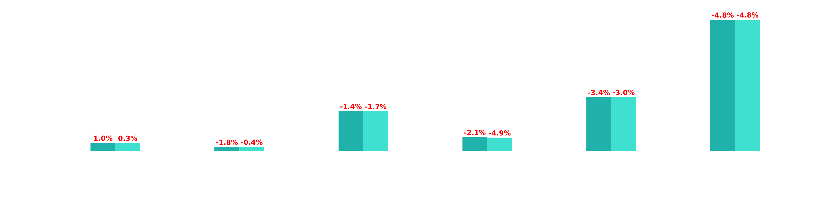
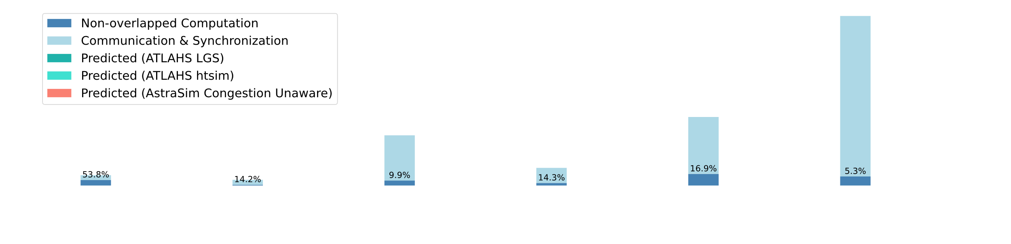
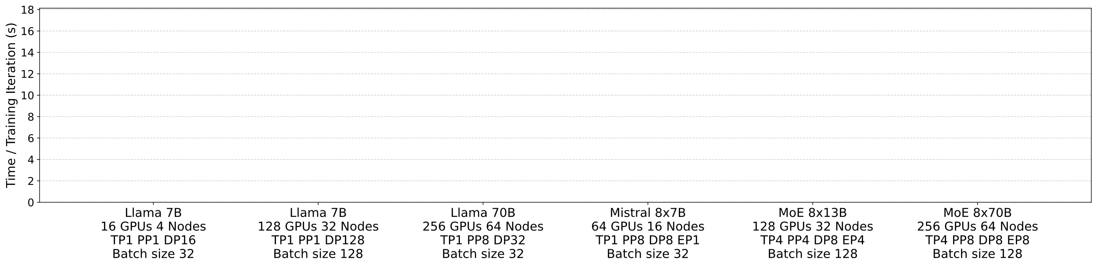
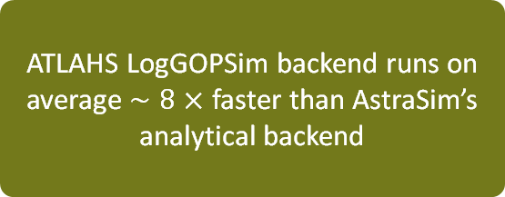
Validation: AI
Alps Supercomputer (CSCS)
AstraSim only executed successfully for two configurations, encountering runtime errors in all other scenarios
ATLAHS LogGOPSim backend runs on average $∼8×$ faster than AstraSim’s analytical backend
Grace Hopper Superchips (GH200)
150 GB/s intra-node communication
25 GB/s Cray Slingshot
Dragonfly topology
TP: Tensor parallelism
PP: Pipeline parallelism
DP: Data parallelism
EP: Expert parallelism
Notes:
Clarify 8x

Slide 13
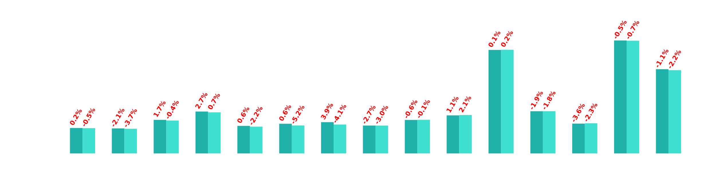
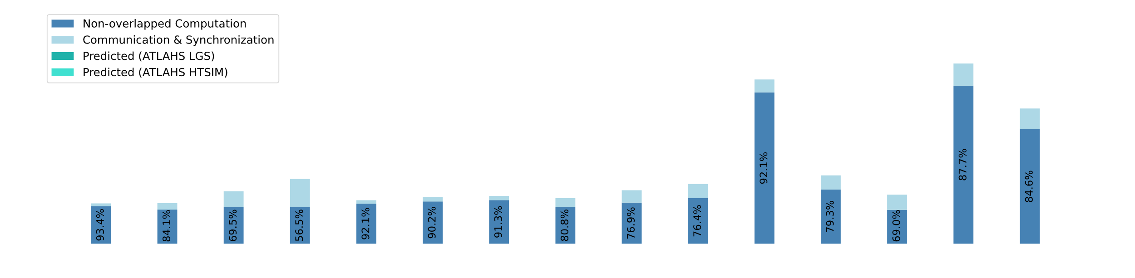
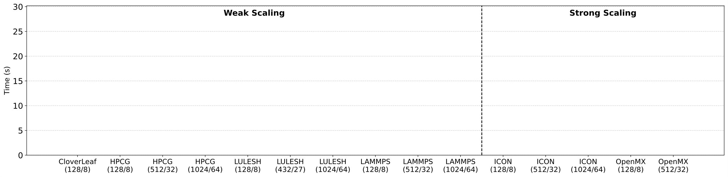
Validation: HPC
188-node Testbed (CSCS)
Intel Xeon E5-2660 v2 CPU
32 GB DDR3 RAM, ConnectX-3 NIC
Fat Tree topology (18 Mellanox SX6036 switches)

Slide 14
Use Cases of ATLAHS
We validated ATLAHS accuracy, but what can it practically be used for?
Estimate runtimes with different network configurations
Study the effect of jobs placement
Study and analyze traffic patterns and bottlenecks
Determine the effect of using different collectives
Compare different congestion control algorithms
Determine the impact of network failures on a variety of workloads

Slide 15
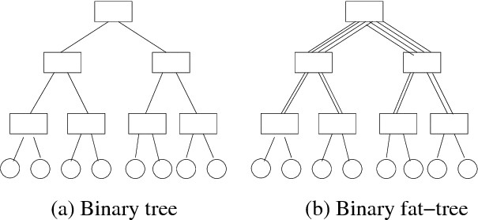
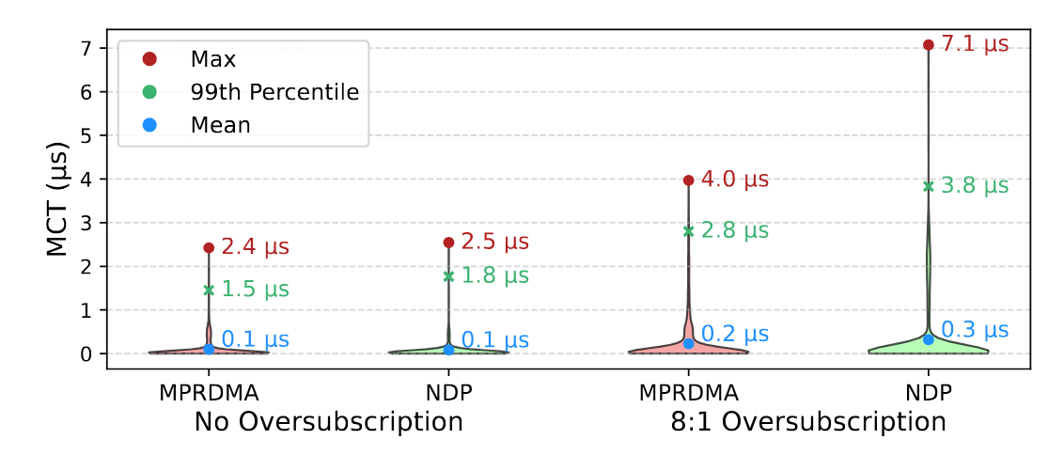
Case Study: Effect of CC on Distributed Storage Requests
Congestion Control Algorithms
Topologies
MPRDMA
Sender-based
Can deal with congetion anywhere in the network
NDP
Receiver-based
Fair and perfect incast performance
htsim simulator setup
400 Gbps network with two different Fat Tree topologies
Comparing MPRDMA and NDP congestion control algorithms
5k storage requests
Non-Oversubscribed
Oversubscribed
With no oversubscription both Congestion Control algorithms have comparable performance.
With oversubscription, NDP, a receiver-based congestion control, struggles to see in-network congestion.

Slide 16
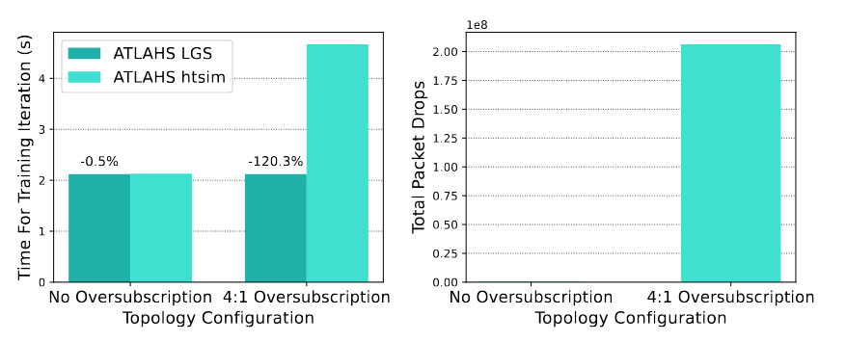
Case Study: ATLAHS LGS vs ATLAHS htsim
If ATLAHS LGS is usually matching ATLAHS htsim, why bother running slow packet-level simulators?
ATLAHS LGS assumes a fully connected topology
ATLAHS LGS assumes no queue build up or congestion handling
ATLAHS LGS assumes no failures or asymmetries
ATLAHS LGS does not model reliability or load balancing
With ATLAHS htsim we can also access more metrics such as packet drops and many more
Simulation Setup
400 Gbps network with two different Fat Tree topologies w
Comparing ATLAHS LGS and ATLAHS htsim
Running Llama 7B

Slide 17
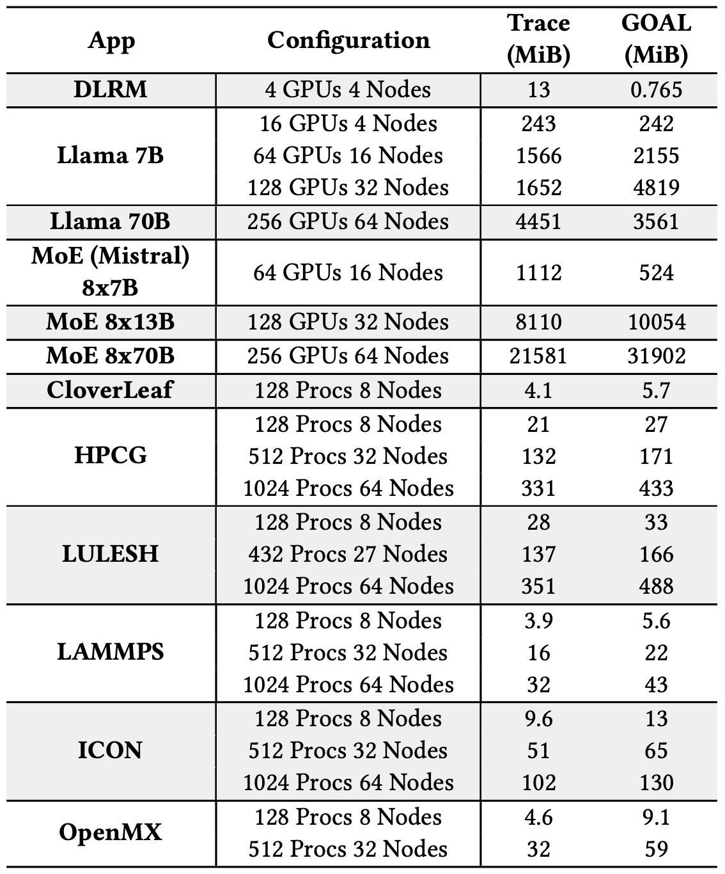
ATLAHS Trace Dataset
Realistic application are critical but also rare for accurate network simulation
We opensource ATLAHS along with all traces collected this work
(unprocessed trace files + GOAL)
The dataset is still growing!

Slide 18



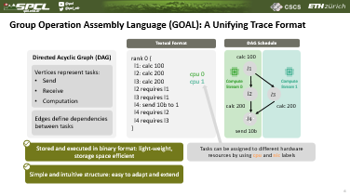
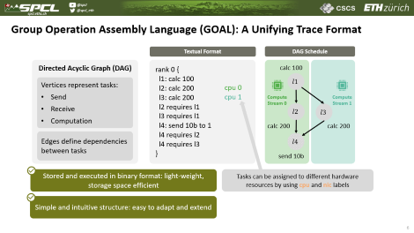
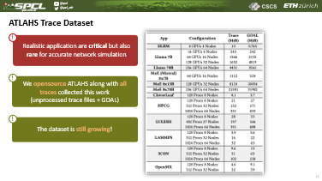
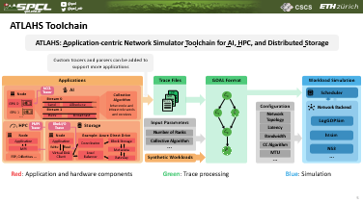
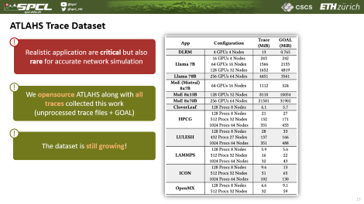

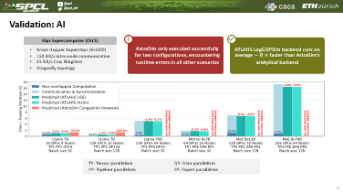
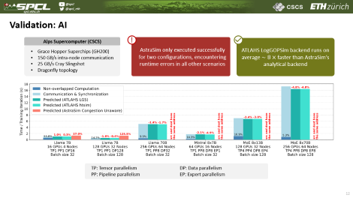
Conclusions
More of SPCL’s research:
youtube.com/@spcl
180+ Talks
twitter.com/spcl_eth
1.4K+ Followers
github.com/spcl
3.8K+ Stars
… or spcl.ethz.ch
Many more results in the paper:
https://arxiv.org/pdf/2505.08936
https://github.com/spcl/atlahs

