Slide 1




Bine Trees: Enhancing Collective Operations
by Optimizing Communication Locality
Daniele De Sensi¹, Saverio Pasqualoni¹, Lorenzo Piarulli¹,
Tommaso Bonato², Seydou Ba³, Matteo Turisini⁴, Jens Domke³, Torsten Hoefler²
¹ Sapienza University of Rome ² ETH Zurich ³ RIKEN R-CCS ⁴ CINECA
The International Conference for High Performance Computing, Networking, Storage, and Analysis
St. Louis, Nov. 16-21
Notes:
17+5

Slide 2
Motivation
Distance-Halving Binomial Tree
0
1
2
3
4
5
6
7

Slide 3
Motivation
Distance-Halving Binomial Tree
Distance-Doubling Binomial Tree
0
1
2
3
4
5
6
7
0
1
2
3
4
5
6
7
Full Global Bandwidth Group X
Full Global Bandwidth Group Y
Full Global Bandwidth Group X
Full Global Bandwidth Group Y

Slide 4
Motivation
Distance-Halving Binomial Tree
(MPICH)
Distance-Doubling Binomial Tree
(Open MPI)
Distance-Halving Binomial Tree
Distance-Doubling Binomial Tree
0
1
2
3
4
5
6
7
0
1
2
3
4
5
6
7
Full Global Bandwidth Group X
Full Global Bandwidth Group Y
Full Global Bandwidth Group X
Full Global Bandwidth Group Y

Slide 5
Motivation: Why not Hierarchical Approaches
Distance-Halving Binomial Tree
Distance-Doubling Binomial Tree
0
1
2
3
4
5
6
7
0
1
2
3
4
5
6
7

Slide 6
Motivation: Why not Hierarchical Approaches
Distance-Halving Binomial Tree
Distance-Doubling Binomial Tree
0
1
2
3
4
5
6
7
0
1
2
3
4
5
6
7

Slide 7




Goal
Reduce rank distance to
reduce usage of oversubscribed links
Do not make assumptions
on topology or node allocation
33% traffic reduction on
oversubscribed links
+60% performance on Leonardo
+80% on LUMI
+2x on MareNostrum5
+5x on Fugaku

Slide 8
Bine Trees Construction

Slide 9
Bine Tree Construction
0
1
2
3
Distance between ranks = 2
Binomial Trees
0
1
Time
2
3
0
1
(Modulo) distance between ranks = 1
Bine Trees
Notes:
Mettere simboletto distanza invece della parentesi

Slide 10
Bine Tree Construction
0
1
2
3
0
1
2
3
4
5
6
7
Binomial Trees
0
1
Time
2
3
0
1
6
7
0
1
2
3
4
5
Bine Trees

Slide 11
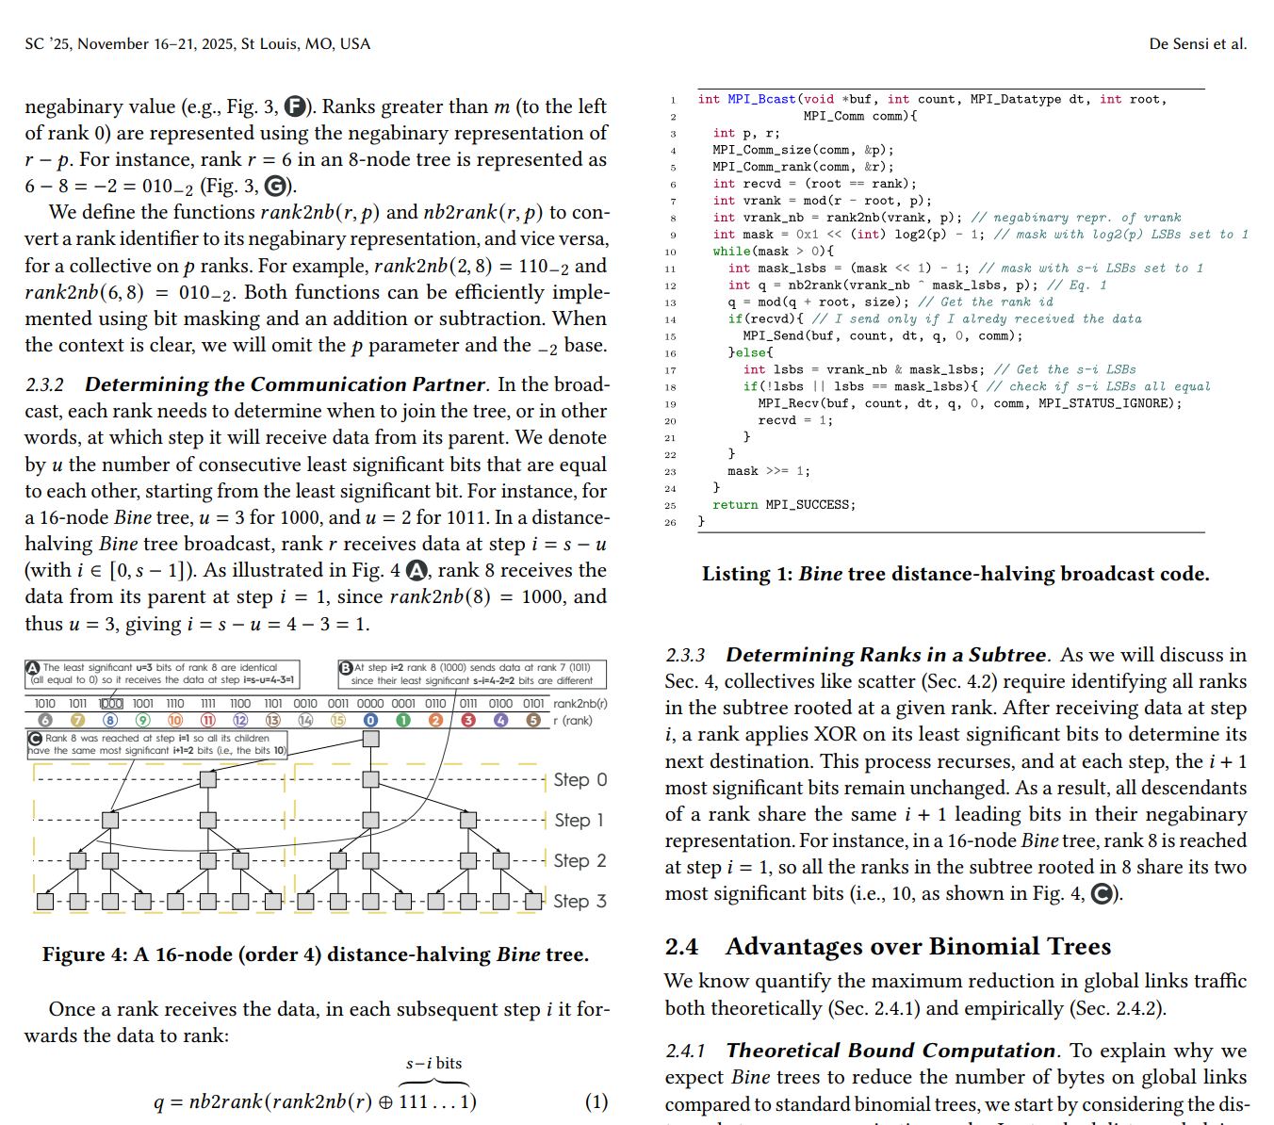
Bine Tree Construction
0
1
2
3
0
1
2
3
4
5
6
7
Binomial Trees
0
1
Time
2
3
0
1
6
7
0
1
2
3
4
5
Bine Trees

Slide 12
Butterflies
0
1
2
3
4
5
6
7

Slide 13
Butterflies
0
1
2
3
4
5
6
7

Slide 14
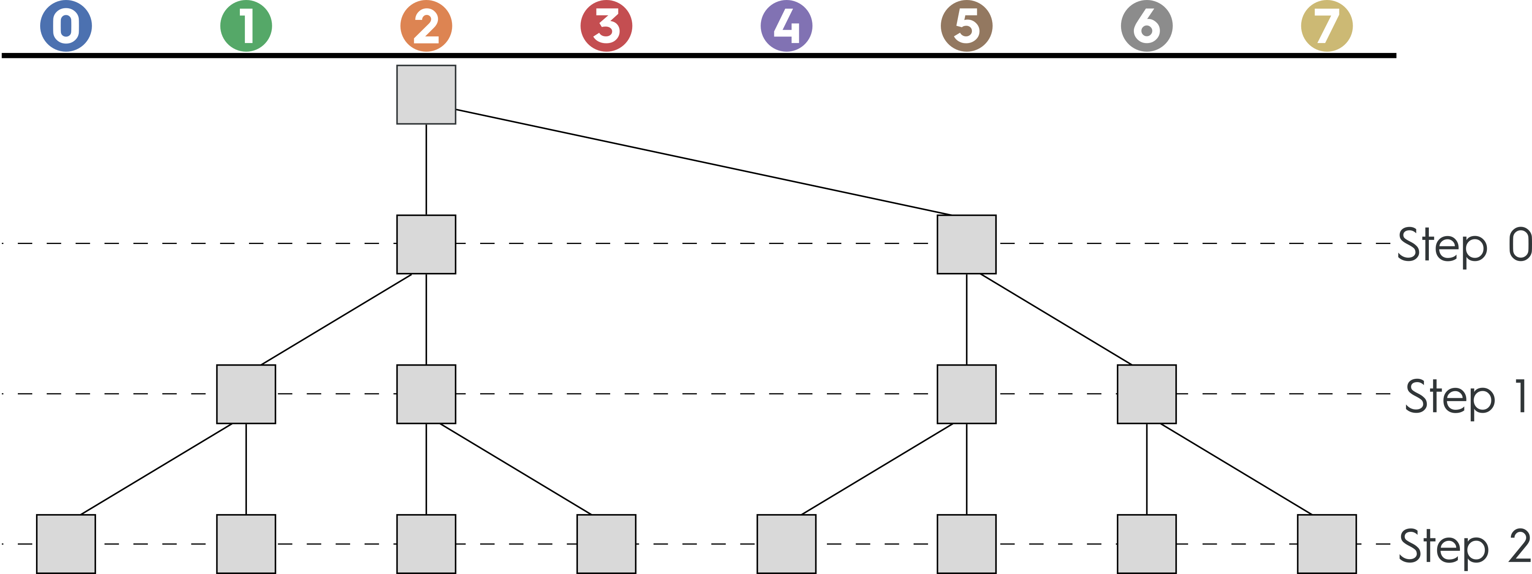
Bine Butterflies

Slide 15
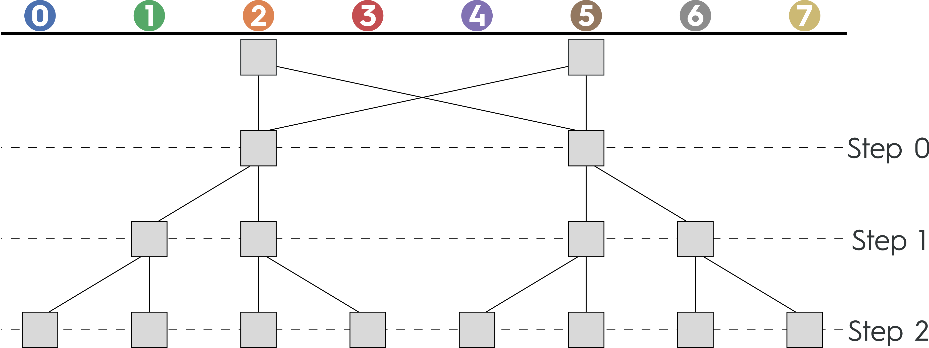
Bine Butterflies

Slide 16
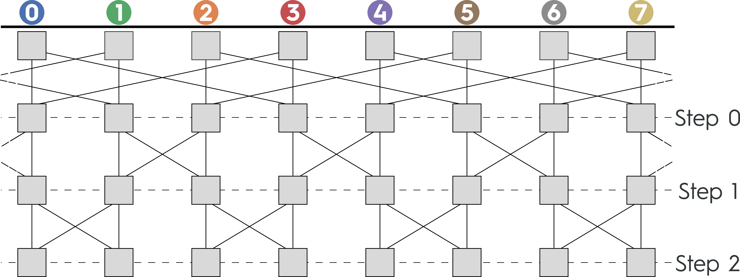
Bine Butterflies

Slide 17
Experimental Evaluation

Slide 18
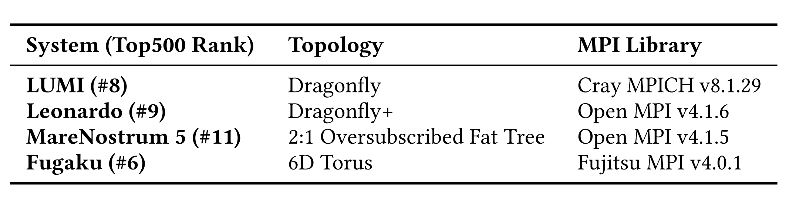
Experimental Evaluation

Slide 19
Bine vs Binomial

Slide 20
Bine vs. Binomial Trees/Butterflies: Leonardo
From 16 to 2,048 nodes, from 32 B to 512 MiB

Slide 21
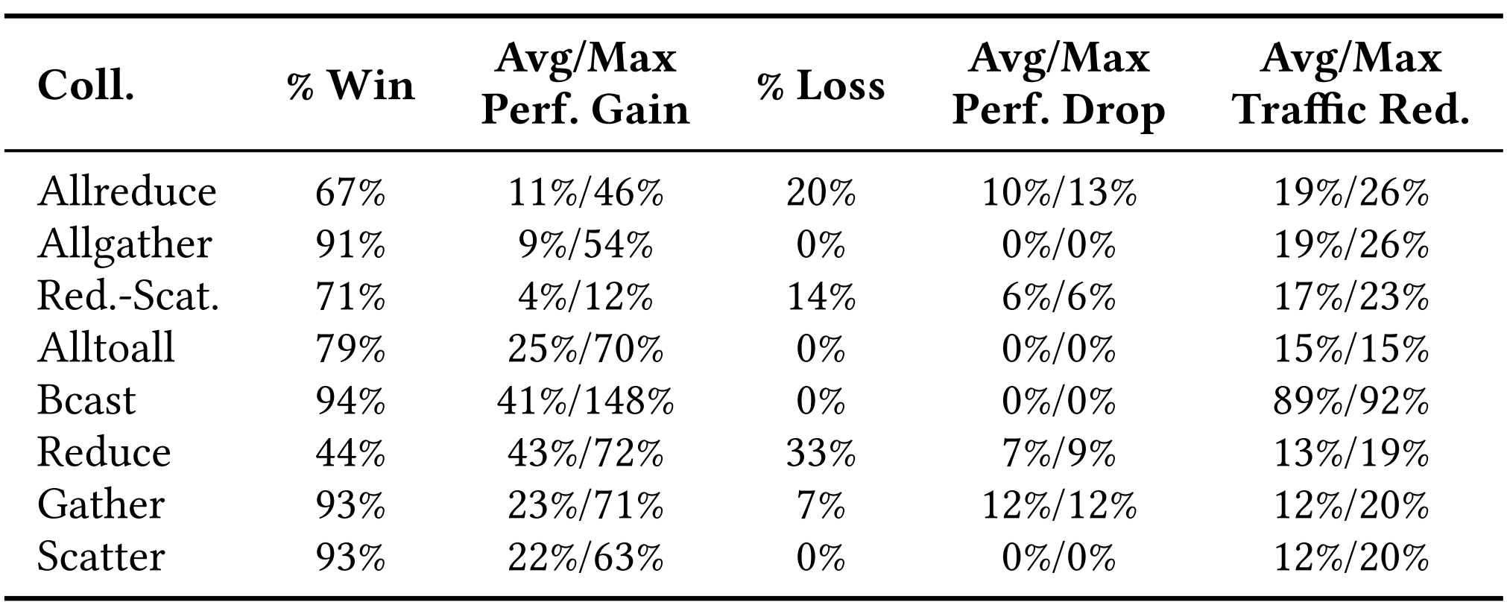
Bine vs. Binomial Trees/Butterflies: Leonardo
From 16 to 2,048 nodes, from 32 B to 512 MiB

Slide 22
Bine vs. Binomial Trees/Butterflies: Leonardo
From 16 to 2,048 nodes, from 32 B to 512 MiB

Slide 23
Bine vs. Binomial Trees/Butterflies: Leonardo
From 16 to 2,048 nodes, from 32 B to 512 MiB

Slide 24
Bine vs. Binomial Trees/Butterflies: Leonardo
From 16 to 2,048 nodes, from 32 B to 512 MiB

Slide 25
Bine vs. Binomial Trees/Butterflies: Leonardo
From 16 to 2,048 nodes, from 32 B to 512 MiB

Slide 26
Bine vs all (including Binomial)

Slide 27
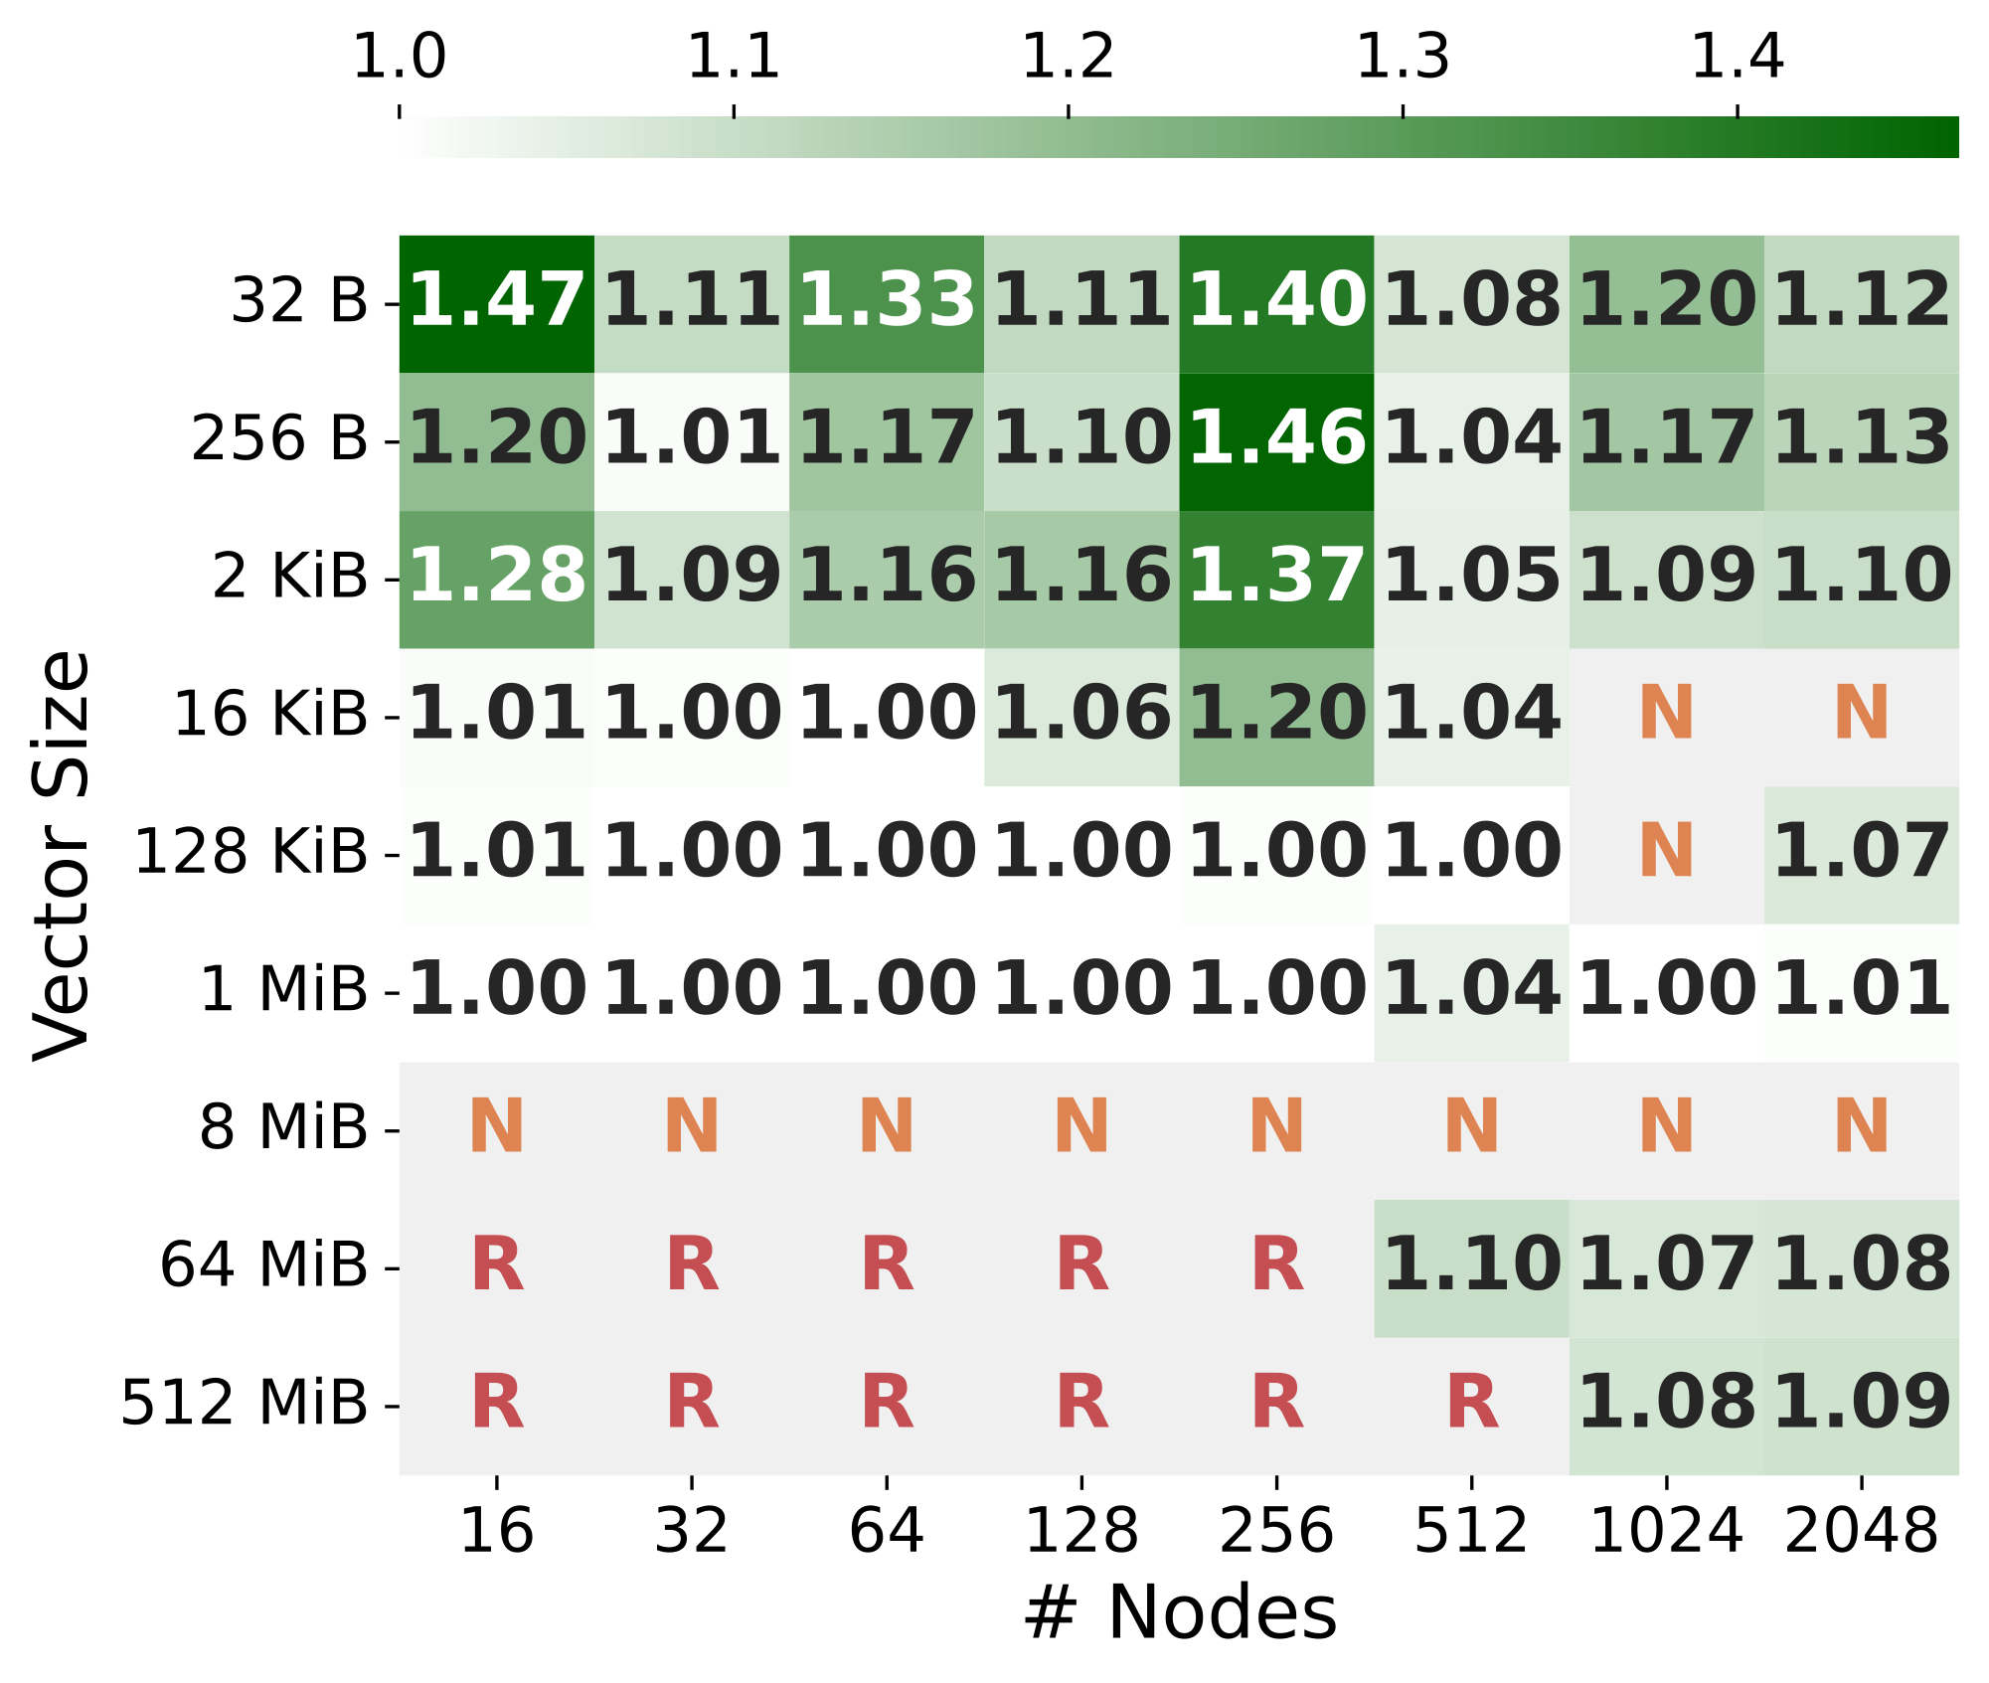
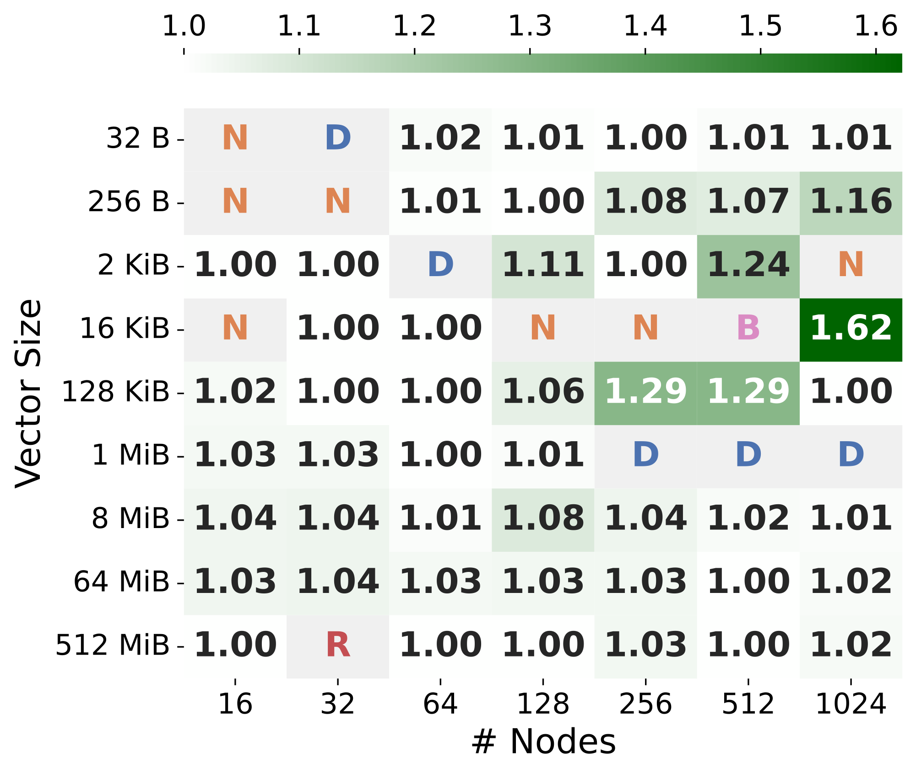
Comparison with State-of-the-art Algorithms
Default
Non-Blocking
Binomial Tree/Butterfly
Ring
Leonardo
LUMI

Slide 28
Conclusions

Slide 29
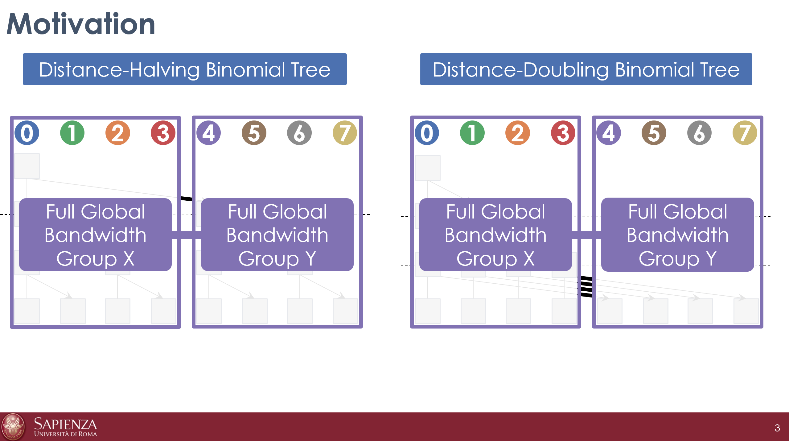
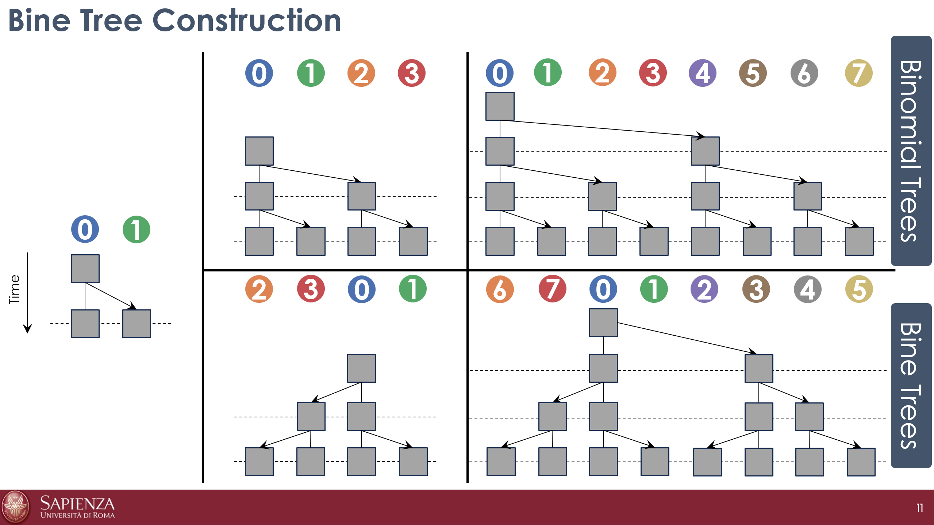



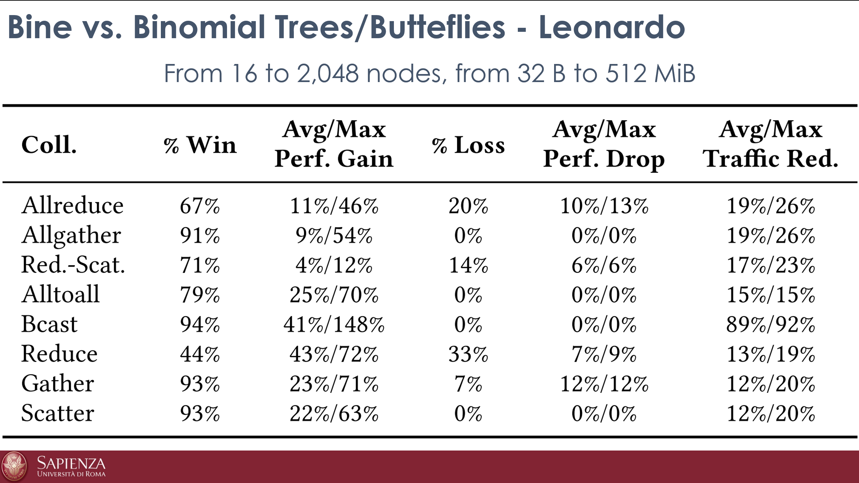
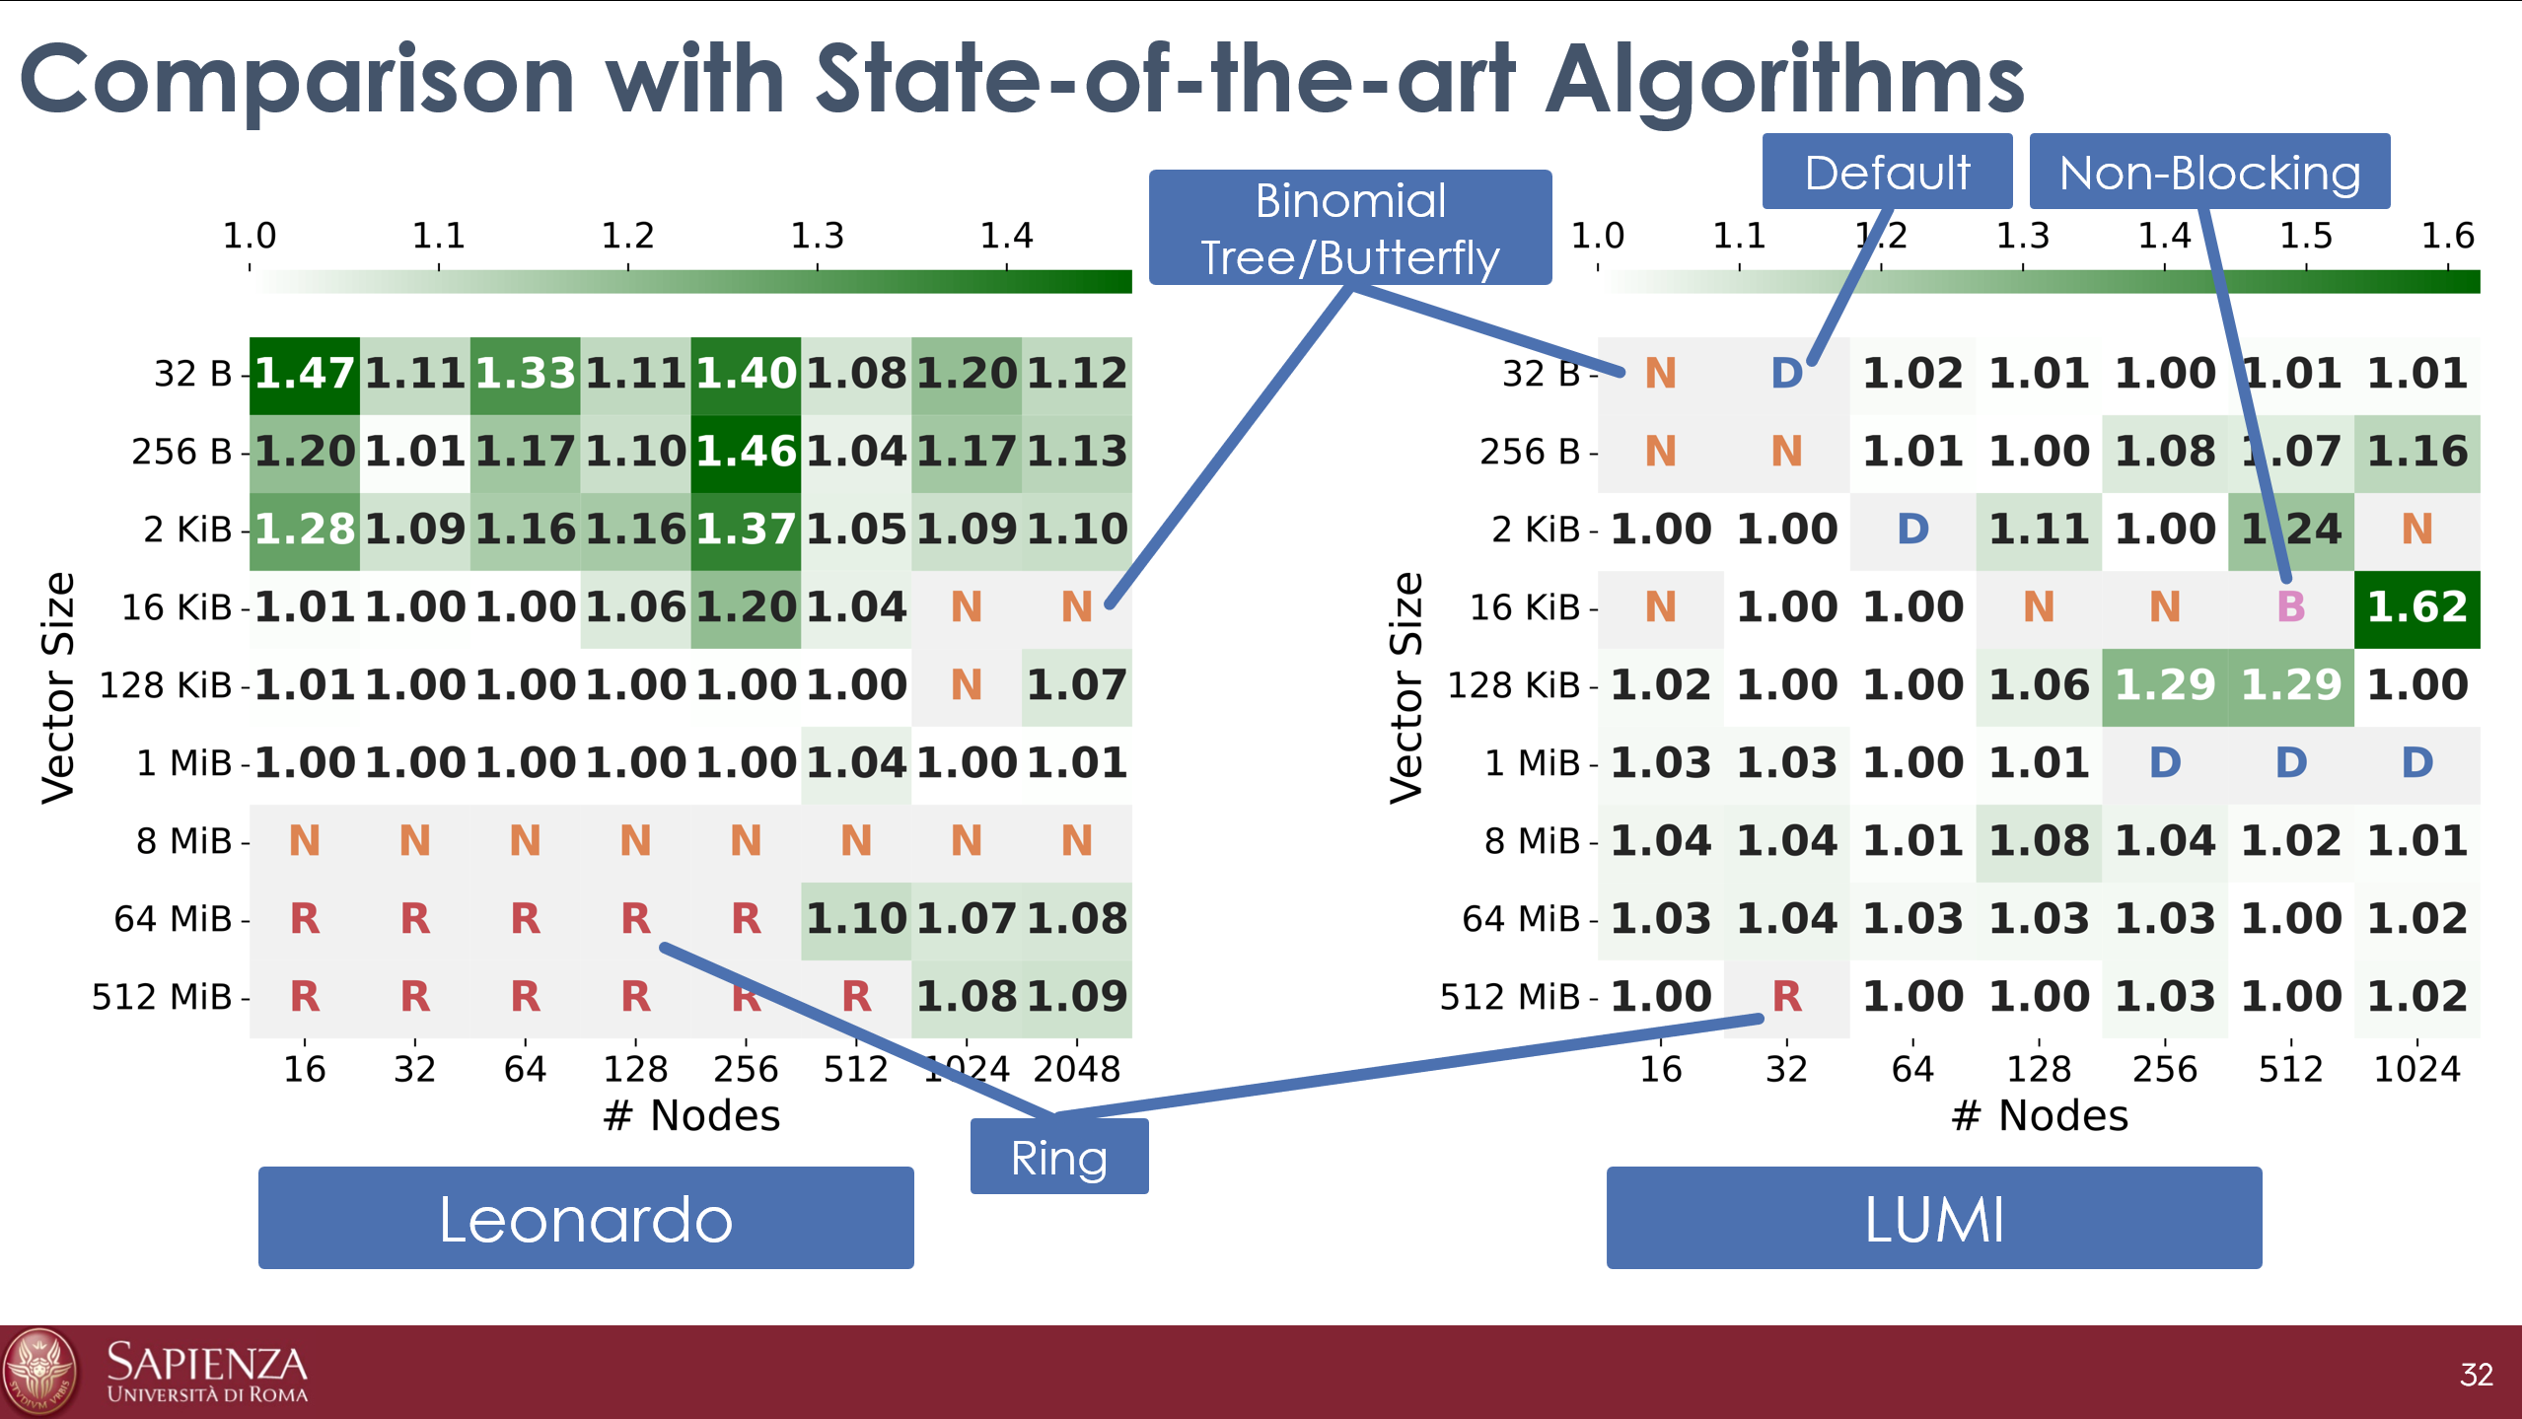





Additional Content
Paper
Correctness Proofs
Important to optimize
communication locality
Bine trees have shorter modulo distance
than standard binomial trees
Source Code
Optimizations for Torus Networks
Leonardo/LUMI/MN5
Fugaku
Traffic reduction on oversubscribed links
and performance improvements
+60% performance on Leonardo
+80% on LUMI
+2x on MareNostrum5
+5x on Fugaku
Hierarchical Multi-GPU
Design and Evaluation
desensi@di.uniroma1.it
https://danieledesensi.github.io
Notes:
Nmon dire dei badge qr etc

